Slide 1
Leadership 26
More Things to Know
About Change

Slide 2
Prayer and Planning

Slide 3
Leading Change 8 Steps
Establishing a Sense of Urgency
Creating a Guiding Coalition
Developing a Vision and Strategy
Communicating the Change Vision
Empowering for Broad-based Action
Generating Short-term Wins
Consolidating Gains and Producing
More Change
8. Anchoring the New in the Culture

Slide 4
6. Generating Short-Term Wins
e.g. of Dave Ramsey
e.g. of Old First Church

Slide 5
6. Generating Short-Term Wins
Three characteristics
1. It’s visible (people can see for themselves)
2. Unambiguous (Obviously a win)
3. Clearly related to change effort

Slide 6
6. Generating Short-Term Wins
Puts pressure on to fulfill vision
Needs a good combination of management and leadership

Slide 7
Leading Change 8 Steps
Establishing a Sense of Urgency
Creating a Guiding Coalition
Developing a Vision and Strategy
Communicating the Change Vision
Empowering for Broad-based Action
Generating Short-term Wins
Consolidating Gains and Producing
More Change
8. Anchoring the New in the Culture

Slide 8
7. Consolidating Gains and Producing More Change
“Resistance: Always Waiting to Reassert Itself”

Slide 9
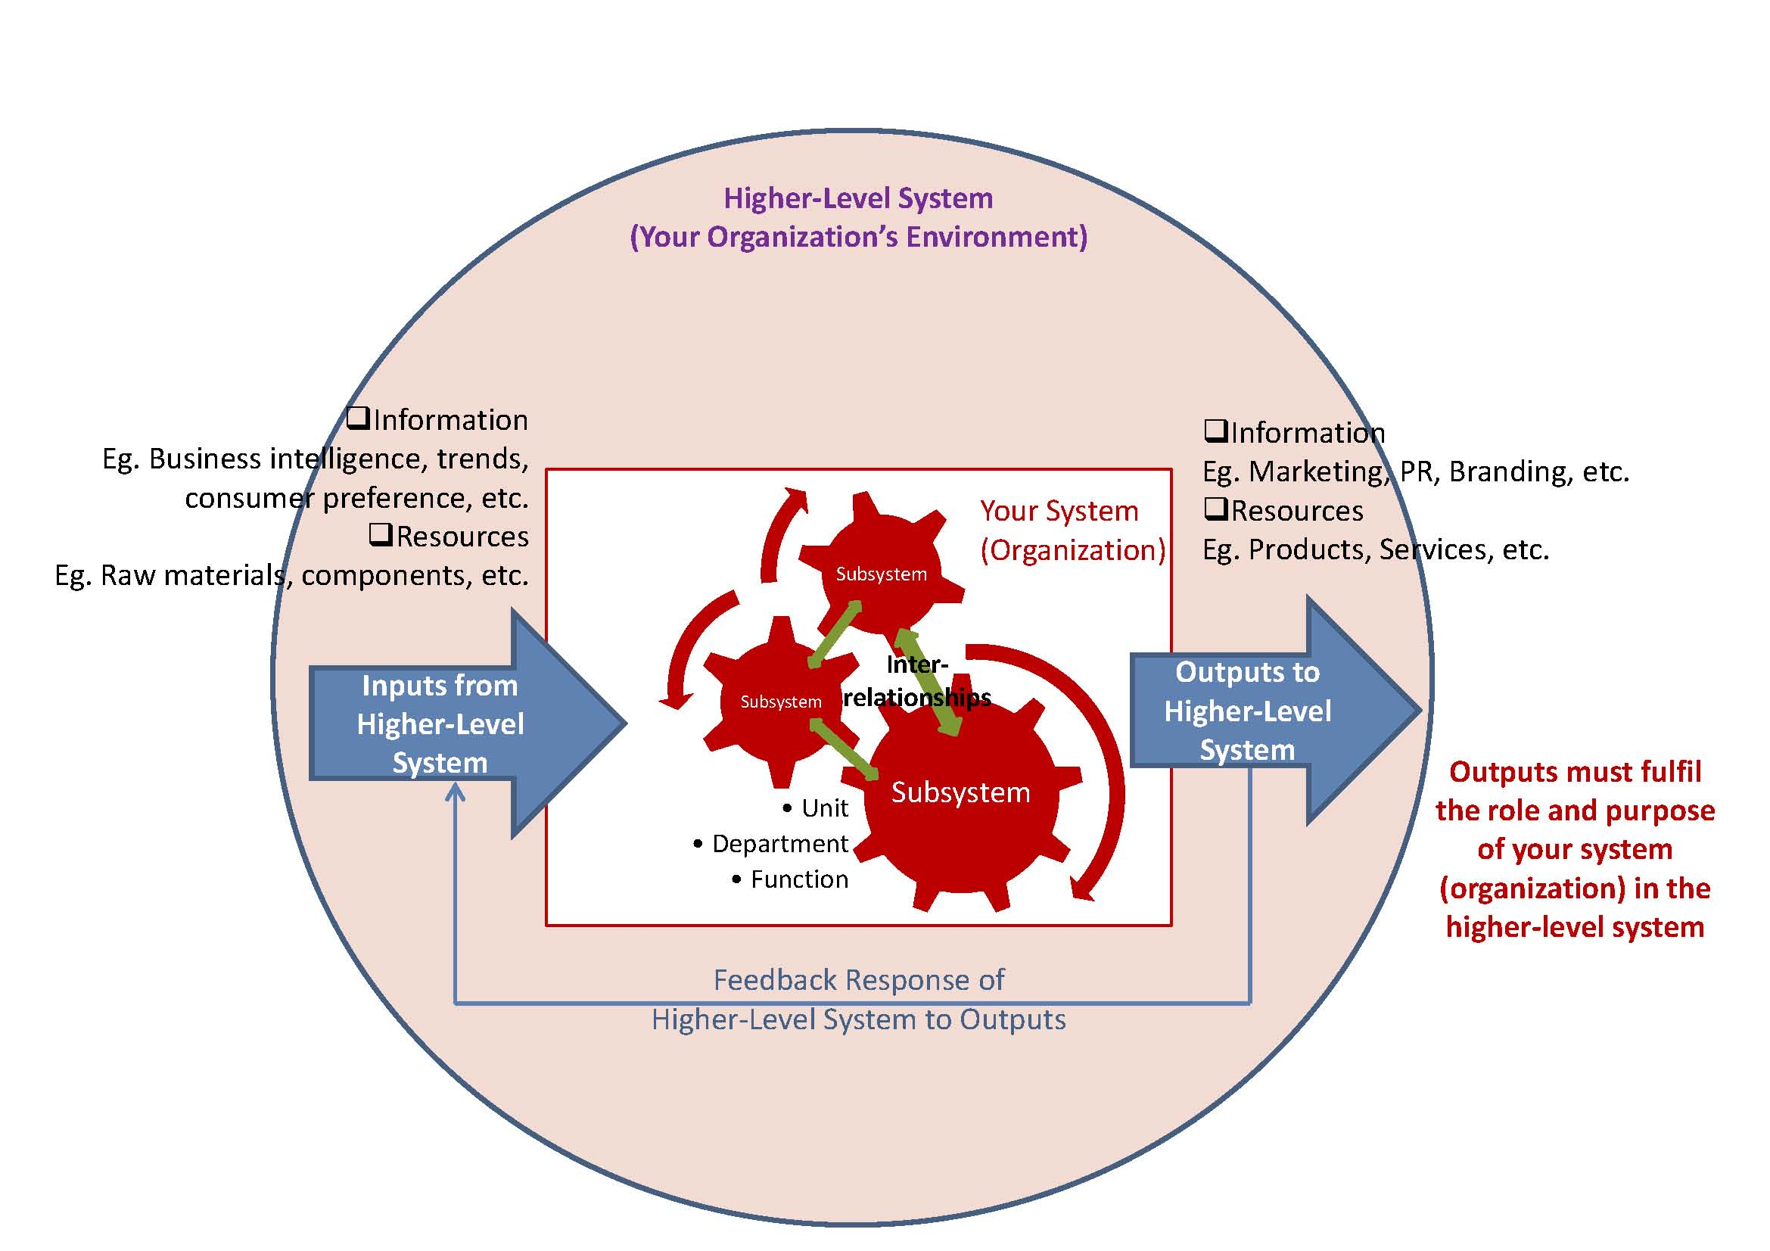

Slide 10
Changing the System can be done.
e.g. Marriage
Husband
Child
Wife
Child

Slide 11
7. Consolidating Gains and Producing More Change
- Introduce more change
- Hire or engage new peopole
- Marginalize critics

Slide 12
Leading Change 8 Steps
Establishing a Sense of Urgency
Creating a Guiding Coalition
Developing a Vision and Strategy
Communicating the Change Vision
Empowering for Broad-based Action
Generating Short-term Wins
Consolidating Gains and Producing
More Change
8. Anchoring the New in the Culture

Slide 13
8. Anchoring New Approaches in the
Culture
- Requires time
- Requires a lot of talk
- Will involve turnover
e.g. of Ten Commandments
- Decisions on succession
e.g. of Coming to CA

Slide 14
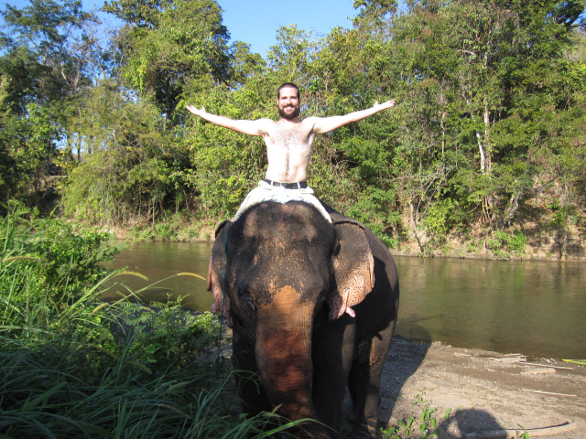
A Final Word About Change

Slide 15
A Final Word About Change
Aim for
Feelings

