Slide 1
Preacher, Preparation,
Presentation
A class on making and preaching sermons
Session 13
Preparing
To
Preach
Kinds of Sermons

Slide 3
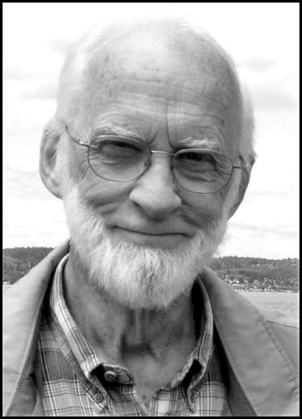

Slide 4
Noutheteo = to warn, admonish, instruct, to lay on someone’s heart.
Nou = mind
Theteo = to put in

Slide 5
“putting sense into someone’s head.”
“indicating duties and obligations.”

Slide 6
“Noutheteo has the connotation of confronting with the intent of changing one’s attitudes and actions.”

Slide 7
“Not with judgmentalism, but with warmth, as in warning a friend away from something dangerous.

Slide 8
“to set right.”
“to impart understanding”
“to correct”
“to counsel”

Slide 9
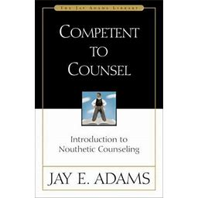

Slide 10
So be on your guard! Remember that for three years I never stopped warning each of you night and day with tears.”
Acts 20:31

Slide 11
“I myself am convinced, my brothers and sisters, that you yourselves are full of goodness, filled with knowledge and competent to instruct one another.”
Romans 15:14

Slide 12
“I am writing this not to shame you but to warn you as my dear children.”
I Corinthians 4:14

Slide 13
“He is the one we proclaim, admonishing and teaching everyone with all wisdom, so that we may present everyone fully mature in Christ.”
Colossians 1:28

Slide 14
“Let the message of Christ dwell among you richly as you teach and admonish one another with all wisdom through psalms, hymns, and songs from the Spirit, singing to God with gratitude in your hearts.”
Colossians 3:16

Slide 15
“Now we ask you, brothers and sisters, to acknowledge those who work hard among you, who care for you in the Lord and who admonish you.”
I Thessalonians 5:12

Slide 16
“And we urge you, brothers and sisters, warn those who are idle and disruptive, encourage the disheartened, help the weak, be patient with everyone.”
I Thessalonians 5:14

Slide 17
“Yet do not regard them as an enemy, but warn them as you would a fellow believer.”
2 Thessalonians 3:15

Slide 18
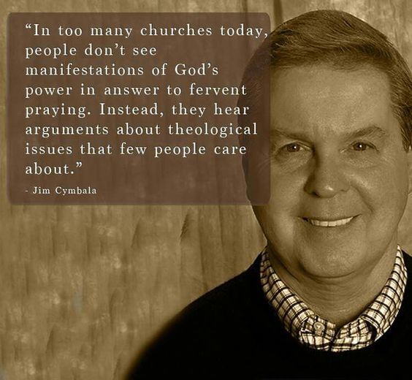

Slide 19
https://www.youtube.com/watch?v=SNEbEXVow_c

