Slide 1
Preacher, Preparation,
Presentation
A class on making and preaching sermons
Session 18
Developing
A Sermon
Introductions are
More Imporant Than
You Think

Slide 2
“I spent the best years of my life
in the arms of another man’s wife.”

Slide 3
Introductions do several things:

Slide 4
Introductions do several things:
Make us want more information
“The snow in the mountains was melting and Bunny had been dead for several weeks before we came to understand the gravity of our situation.”

Slide 5
Introductions do several things:
Make us want more information
Introduce the theme
“It was the best of times, it was the worse of times, it was the age of wisdom, it was the age of foolishness….”
- Poverty/wealth, power/poweflessness

Slide 6
Introductions do several things:
Make us want more information
Introduce the theme
Set a tone
“Mr. and Mrs. Dursley, of number four, Privet Drive, were proud to say that they were perfectly normal, thank you very much.”

Slide 7
Introductions do several things:
Make us want more information
Introduce the theme
Set a tone
Gain credibility for us

Slide 8
What kinds of introductions work well?
1. A story

Slide 9
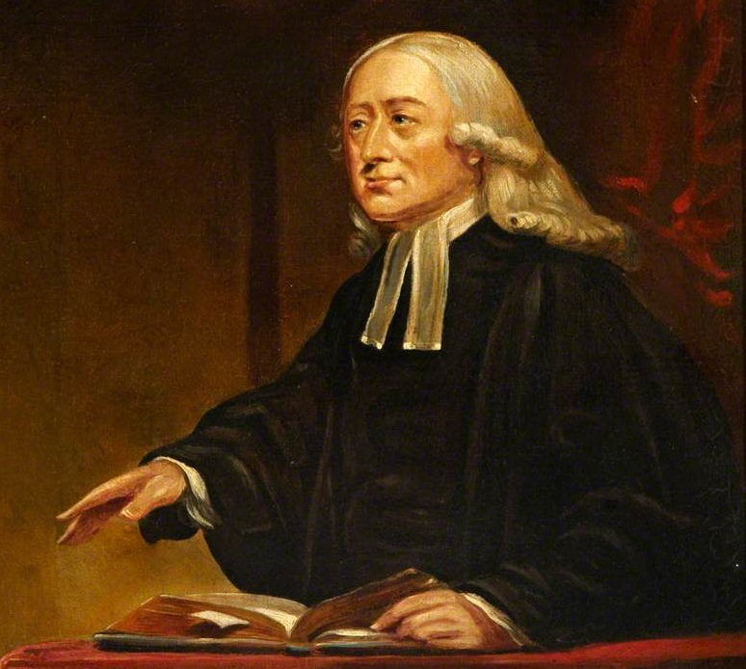

Slide 10
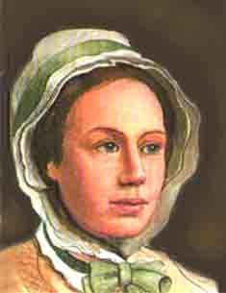

Slide 11
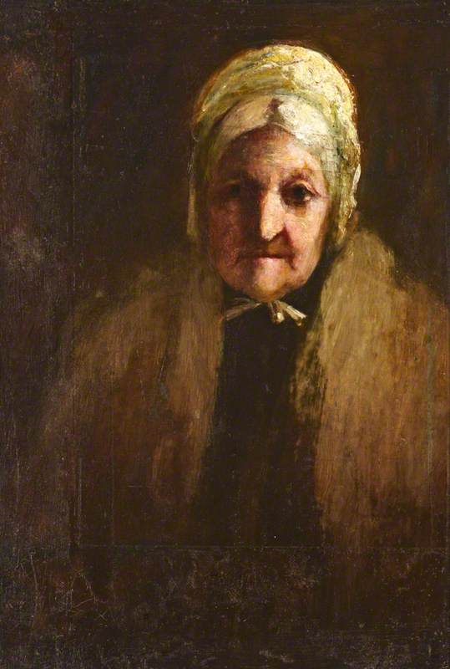

Slide 12
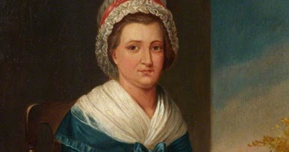

Slide 13
“How do you know God’s will?”

Slide 14
https://youtu.be/9iwRIIj0Vrw

Slide 15
Personal Stories

Slide 16
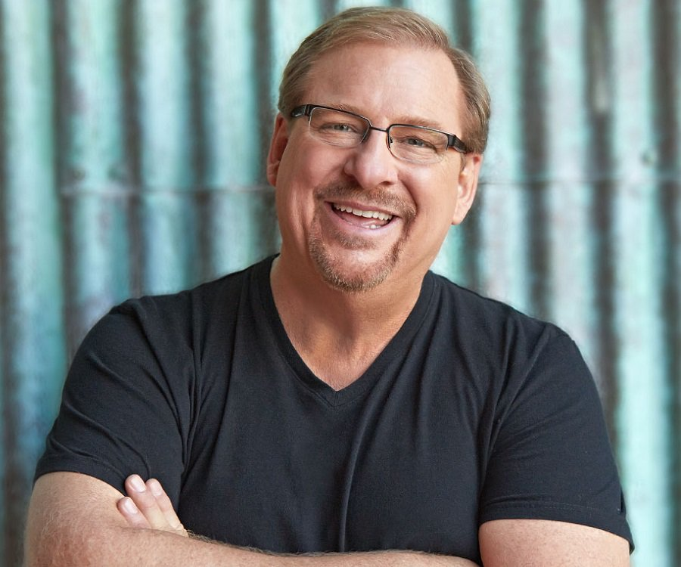

Slide 18
Personal Story
“Not the hero”

