Slide 1
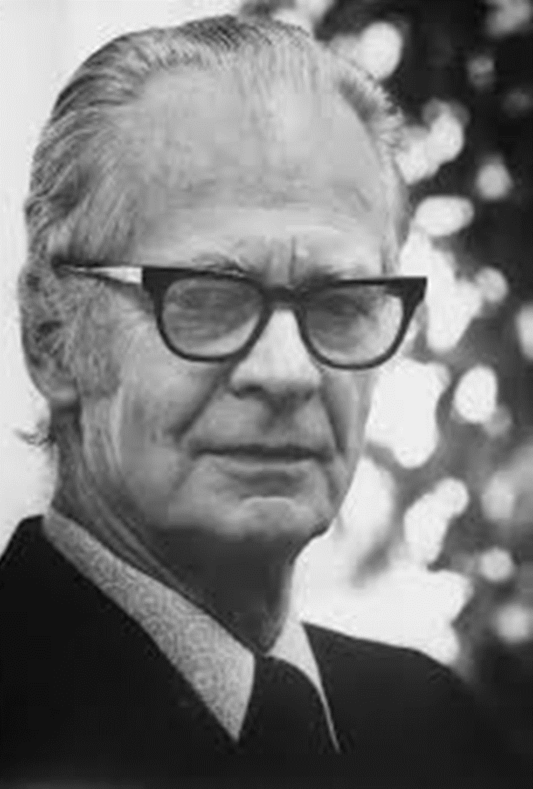
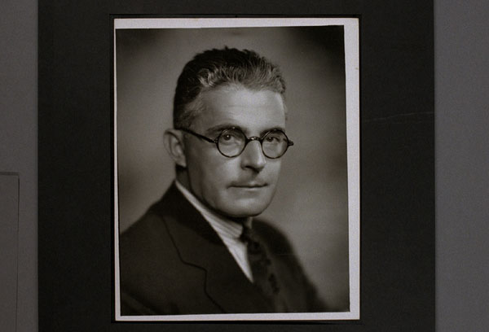
B. F. Skinner & John Watson
Focused their research entirely on behavior, to the exclusion of any kinds of mental processes.

Slide 2
B. F. Skinner & John Watson
Conditioning — the ability to connect stimuli (the changes that occur in the environment) with responses (behaviors or other actions).

Slide 4
Other Types of Learning
Insight, Observational Learning (modelling)

Slide 8
Albert Bandura
Social Learning Theory

