Slide 1
8 Marriage and Family

Slide 2
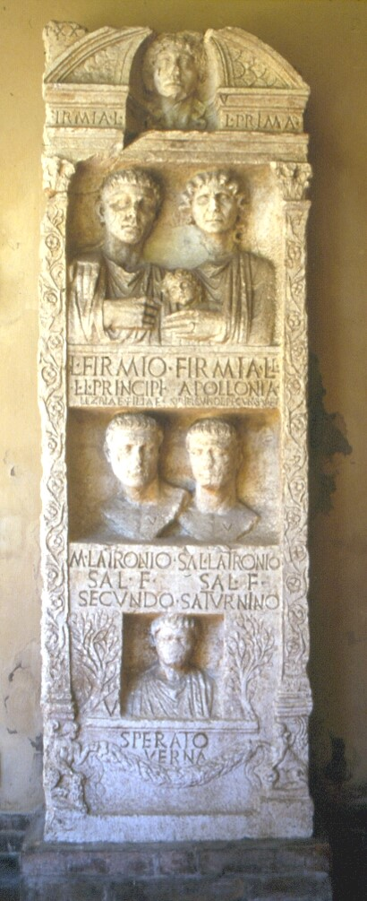
Family as most common
social and biblical metaphor

Slide 3
Meanings of family:
-vertical
-horizontal
-residents of house
(-but not nuclear)

Slide 4
Marriage as contract between two families
Marriage cum manu, sine manu

Slide 5
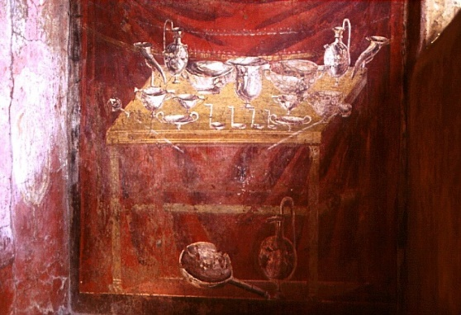
Age at Marriage
Divorce

