Slide 1
18 Women Deacons

Slide 2
Phoebe 16:1, diakonos
Compare Phil 1:1
Pliny’s ancillae ministrae

Slide 3
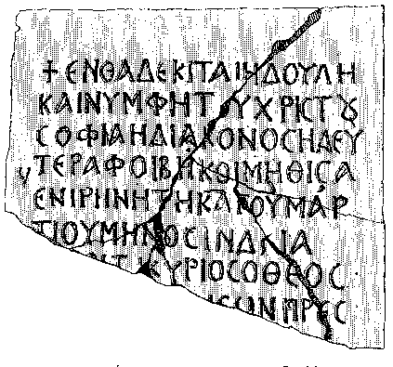
Diakonos, diakonē, diakonissa used interchangeably even quite late
Abbreviation on inscription often diak
Sophia, slave and bride of Christ, deacon, second Phoebe

Slide 4
Didascalia/Apostolic Constitutions have them as part of the clergy
Principal role: ministry to women

Slide 5
Ign. Magn. 6. Bishop-deacon-presbyter; here deaconess added. Trinitarian typology
Novellae 6.6 (Constantinople, 6th cent.): 100 male deacons, 40 female deacons to be supported at Hagia Sophia

