Slide 1
Christian Leader’s Institute: World History 101 The Beginnings of “Civilization” to 1500 A.D.
Rev. Richard Hamstra, B.A., M.Div, M.A.

Slide 2
Introductory Matters
Why Study History?
Assumptions
What does one study when one studies history?
Sources
When does history begin?
Characteristics of early civilizations

Slide 3
Why Study History as a part of your CLI education?
To increase your awareness of CONTEXT
To increase your awareness of PERSPECTIVE (our own assumptions; limits of objectivity)
To increase your knowledge of the HUMAN CONDITION (It was the best of times. It was the worst of times)
To marvel at the variety of human SOLUTIONS (human adaptability, human inventions—creatures who make tools to make tools, multiple ways to organize life)

Slide 4
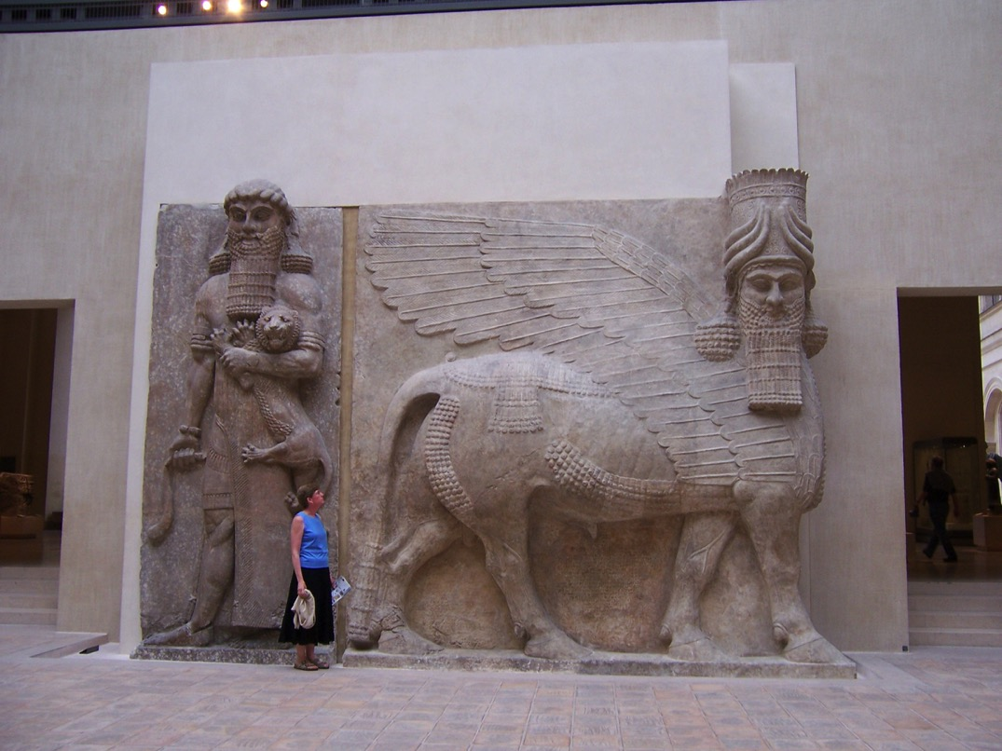

Slide 5
Assumptions
“No man ever steps in the same river twice, for it's not the same river and he's not the same man.”
Heraclitus, 6th Cent. B.C. Greek Philosopher
21st. Cent. American, white, 60 plus, male, Christian, pastor.

Slide 6
What does one study when one studies human history?
The stories, values, organizations, cultures, artifacts, of human groups and individuals of the past. History is often the story of how people order and make sense out of their experience---it is often about control or alignment with perceived greater forces in their experience.

Slide 7
What are the sources for studying human history?
Generally three types of sources:
1. Primary
2. Secondary
3. Environmental

Slide 8
1. Primary Sources
Primary Sources are those things directly left behind by past people, e.g.
archeological artifacts (carefully documented in the context in which the object was discovered!)
writings (carefully understood in the context in which they were written, edited, or produced!)

Slide 9
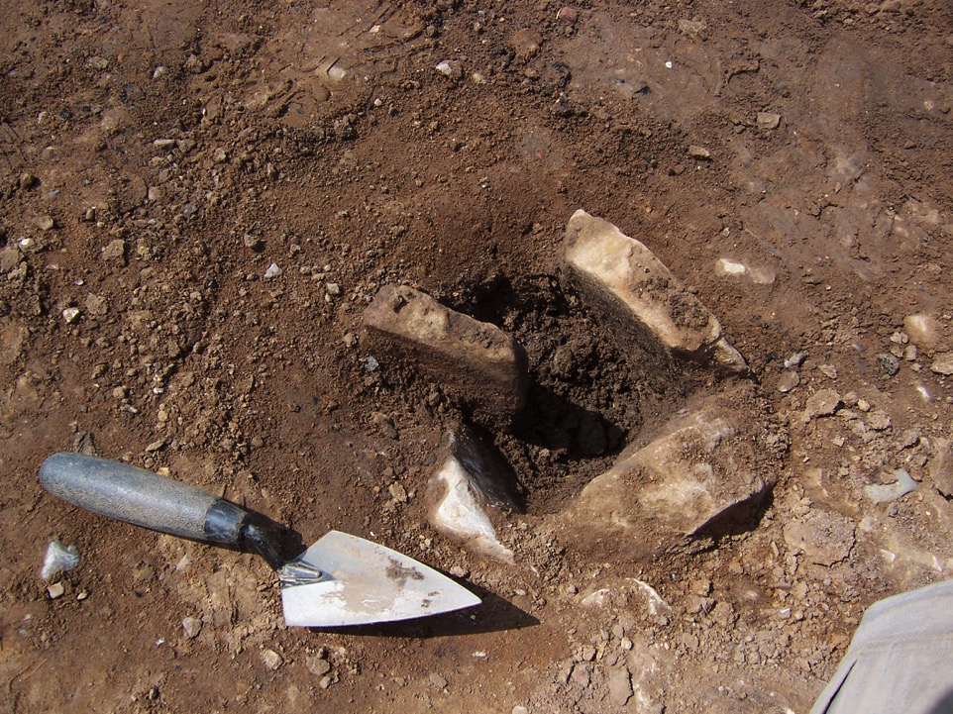

Slide 10
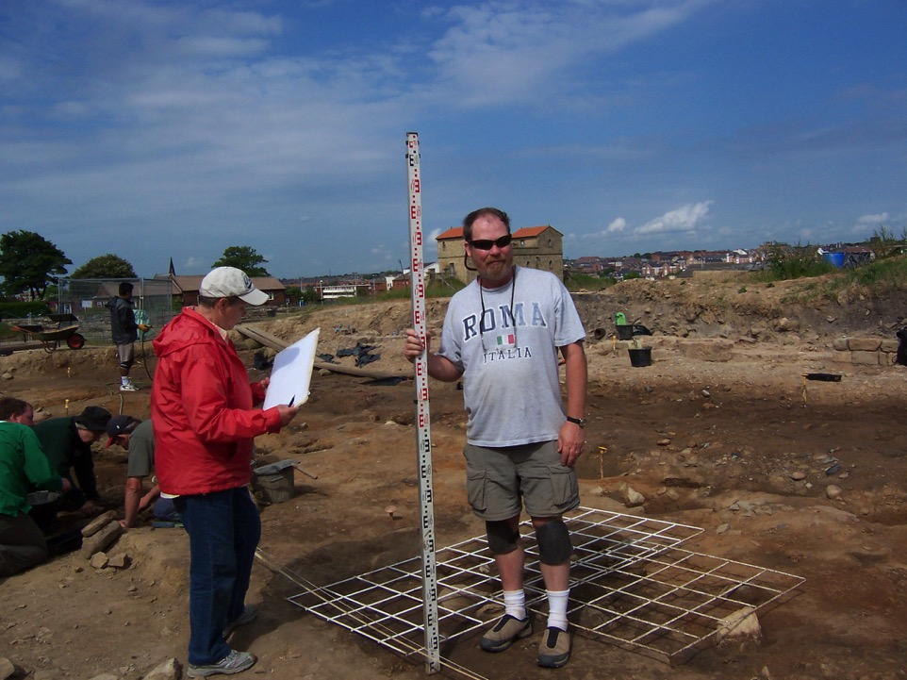

Slide 11
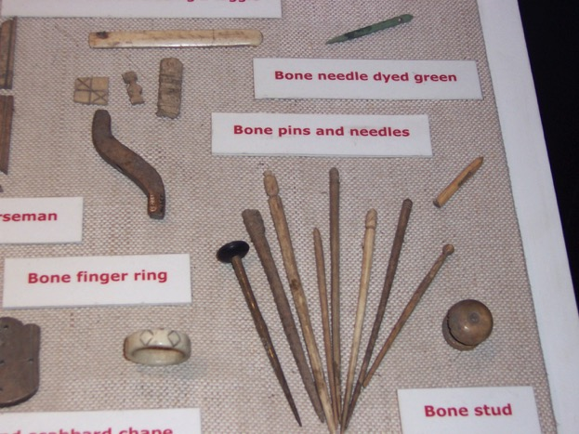

Slide 12
2. Secondary Sources
What someone has written or spoken about the past, e.g.
textbooks
articles
lectures
online comments
biographies
stories

Slide 13
3. Environmental/Genetic Source Evidence
Environmental: This type of evidence is not purposely produced by people of the past but relates to the physical, creational, natural, world in which people lived, e.g.

Slide 14
Environment Matters!
Environmental conditions such as mountains, rivers, shorelines, forests, deserts, etc… require different solutions/adaptations for a culture to flourish. People always live in the context of a particular environment.
The various ice ages affected the environment tremendously and led to significant migrations of people.

Slide 15
Genetics
One way historians trace the various migrations is by studying genetics.
Cf. The National Geographic production: The Human Family Tree: https://www.youtube.com/watch?v=p3D3KX0l7M8

Slide 16
So when does history begin?
1. “In the beginning……”
2. Traditionally, and for the purposes of this course, “history” begins with groups that began to use some form of writing or record keeping, hence the recorded data for us is generally more complete.
3. Often, cultures and eras without a writing system, are understood as “pre-historic”.

Slide 17
The written word
1. Most often writing arose as a form of record keeping, without which a group with diverse sub-groups, could not function, e.g.
A. Owners, workers, and slaves
B. Warriors and farmers
C. Royalty and Priests

Slide 18
2. Writing began as a means to designate what belonged to whom---bookkeeping, generally, only the scribes knew how to write anything complex.
3. The owner’s seal (stamp) is one of earliest reasons to create systems of markings that could be identified by others (i.e. read). Most of the earliest written artifacts are seals or lists of inventory of property and trade goods.
4. Implies an already existing diversified society with ownership a high value.

Slide 19
A socially diversified, agriculturally based settlement—is an “ancient city”….i.e. a CIVILIZATION
Previously ancients were variously organized for living according to clans, e.g.
1 Hunter/gatherers
2. nomads/pastoralists
3. Slash and burn harvesters

Slide 20
Sustainable Agriculture
An essential condition for a settlement of larger size was the sustainable (reliable) cultivation of crops—often cereals.
Domestication of animals predates cultivation, however, consistent animal populations (or seafood) contributed greatly to a civilization’s prosperity.
Often irrigation was a key element to the sustainability of cultivation and hence the establishment of a civilization.

Slide 22
The Agricultural Revolution
Began around 10,000 B.C. (Neolithic Age)
Middle East—ca. 8000 B.C. (wheat/barley)
Greece —ca. 6000 B.C. (wheat/barley)
Egypt—ca. 5000 B.C. (wheat/barley)
S. China/N. India –ca. 5000 B.C. (rice)
Central Europe—ca. 4000 B.C.(wheat/barley)
Mesoamerica and Peru—ca. 3000 B.C. (potatoes/maize)

Slide 23
Bronze Age (ca. 3200 B.C.)
Perhaps discovered in Caucasus Mountains (between the Caspian and Black seas), the mixture of refined tin and copper produced bronze. Some civilizations arose during the confluence of sustainable agriculture and the early bronze age, e.g. Sumer, Egypt, and Greece.

Slide 25
Common Characteristics of many early civilizations
Sustainable agriculture
Diversification of social/economic roles
Use of new technologies (irrigation, bronze)
Creation of record keeping (writing)

Slide 26
6 Centers of Early Civilization

Slide 27
Between 5000 and 3500 B.C.
Mesopotamia
India
China
Egypt
Peru
Mesoamerica

Slide 28
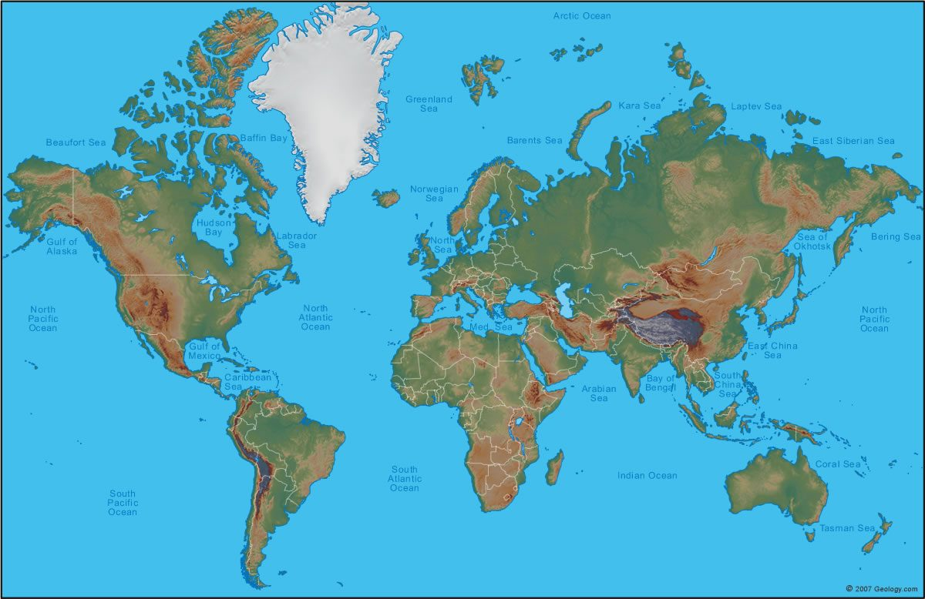
http://geology.com/world/world-physical-map.jpg

Slide 29
Indo/Europeans

Slide 30
READING ASSIGNMENT about Indo/Europeans
https://en.wikipedia.org/wiki/Proto-Indo-Europeans
Especially the introduction through section on Culture

Slide 31
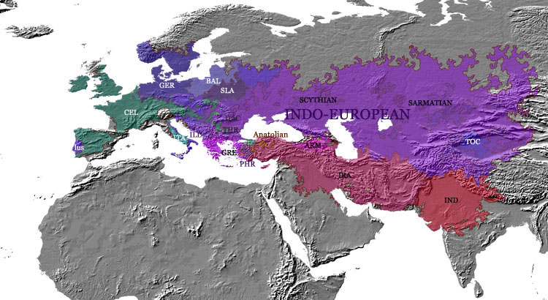
https://upload.wikimedia.org/wikipedia/commons/8/80/Indo-european_-_languages_-_evolution_-_500_BC_-_map.jpg

Slide 32
Indo/European influence
A language group not ethnic/racial, includes Sanskrit
Likely originated in the Caucasus Mountain region between the Black and the Caspian Seas—ca. 6000 B.C. Proto-Indo/European
Around 3500 B.C. refugees, migrants, conquers??? Fanned out in every direction,—east to India(Sanskrit) and China, south to Persia(Old Persian), west to Europe (Greek, Albanian, Germanic, Celtic, Anatolia) and north (parts of southern Russia and Baltic).

Slide 33
I/E influence cont.
Likely domesticated the horse and invented the wheel.
Religion: sky-god, rather than mother earth goddess as the chief deity
Patriarchal rather than matriarchal in family dynamics
Oral heroic stories and poetry

