Slide 1
Preacher, Preparation,
Presentation
A class on making and preaching sermons
Session 26
Presenting
Your Sermon
Make Your
Message
Memorable
Positive
Words

Slide 2
What Do People Remember?
10% of what we read
20% of what we hear
30% of what we see
50% of what we see and hear
70% of what we discuss
80% of what we experience
90% of what we teach

Slide 3
Presentation
Trumps
Information

Slide 4
How do you make a sermon
memorable?
1. Use picture-language

Slide 5
How do you make a sermon
memorable?
Use picture-language
“Words have power”

Slide 6
Sinners in the Hands of an Angry God

Slide 7
https://youtu.be/3x41rWyUgn4

Slide 8
5 to 1
Find the study here:
https://hbr.org/2013/03/the-ideal-praise-to-criticism

Slide 9
Choosing Your Words
- Judgment with tears
- Luke 6:45
“A good man brings good things out of the good stored up in his heart…”
- Be Aware

Slide 10
How do you make a sermon
memorable?
Use picture-language
“Words have power”
Preach with Passion

Slide 12
What it is not
- drama
- overworked gestures
- loud voice
- tears
It’s easy to “mimic” passion

Slide 13
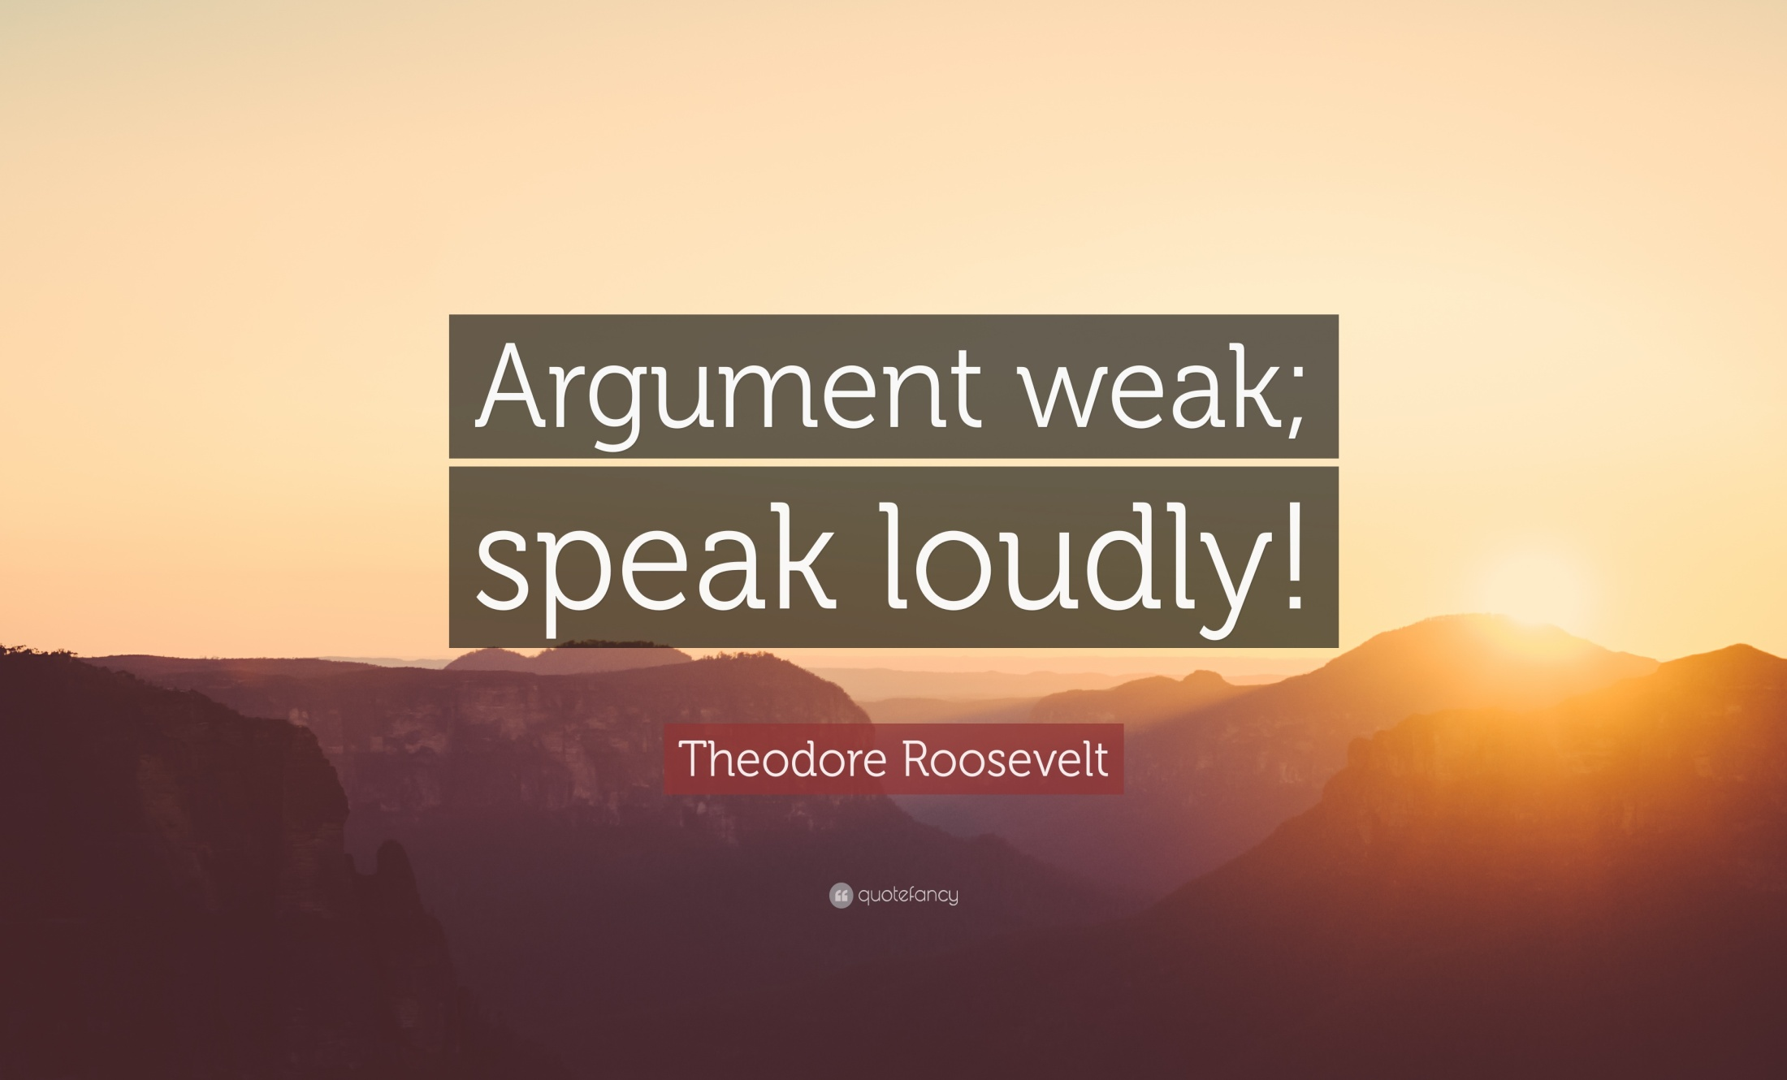

Slide 14
https://youtu.be/WSjxu0pGDcU

Slide 15
How do you gain passion?
- Pray
- Prepare
- Present
Let go…

Slide 16
