Slide 1
Leadership 32
Spiritual Warfare 1

Slide 2
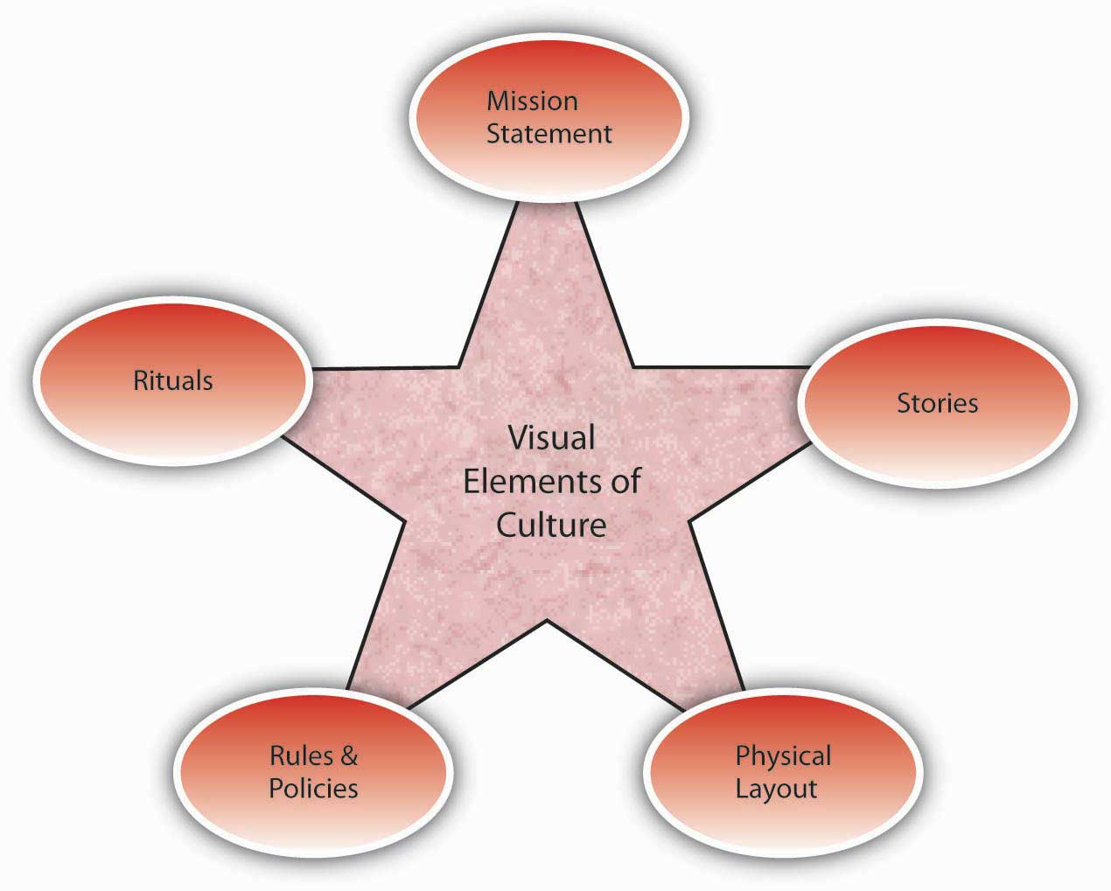
Vision
Culture
Prayer and Planning
Leader

Slide 3
A leader, with all his plusses and minuses, strengths and weaknesses, interacts with a group of people to define the culture (the way things are done here) in order to develop a vision for a preferable future, and then provides the impetus for doing the actions necessary to bring about that future with plans and prayer.

Slide 4
Spiritual Warfare Introduction
“Screwtape Letters” C.S. Lewis
Reading Ephesians 6:10-18
Seminary --- 0

Slide 6
Know Your Enemy
Who Is He?
Ezekiel 28:12-17
Isaiah 14:12-15
Revelation 12:7-9

Slide 7
Know Your Enemy
Who Is He?
His Names
Satan =
The Accuser Revelation 12:10
Lucifer (Lightbearer) Isaiah 14:12
Angel of Light 2 Corinthians 11:14
Devil = Slanderer I Timothy 5:14
Deceiver Revelation 20:10

Slide 8
The Prince of this World John 12:31
Prince of the power of
the air Ephesians 2:2
God of this age 2 Cor. 4:4
Murderer and liar John 8:44
The Tempter Matthew 4:3
Roaring Lion I Peter 5:8

Slide 9
The Devil was fairly voted out
And of course, the Devil’s gone.
But simple folk would like to know
Who carries his business on?

