Slide 1
Leadership 13
Vision Introduction
“I Have a Dream”

Slide 2
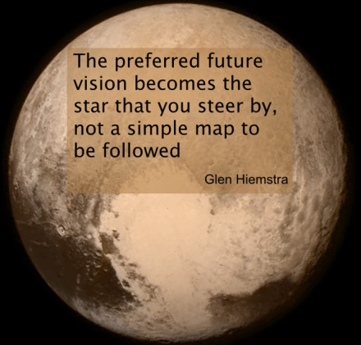
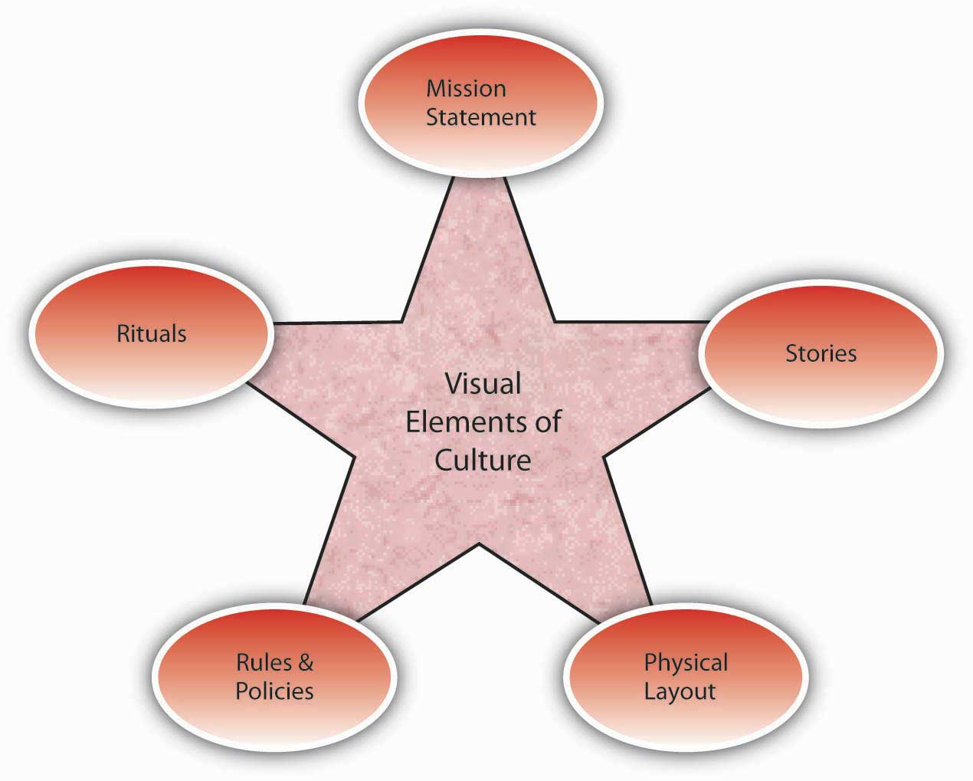
Vision
Culture
Prayer and Planning
Leader

Slide 3
A leader, with all his plusses and minuses, strengths and weaknesses, interacts with a group of people to define the culture (the way things are done here) in order to develop a vision for a preferable future, and then provides the impetus for doing the actions necessary to bring about that future with plans and prayer.

Slide 5
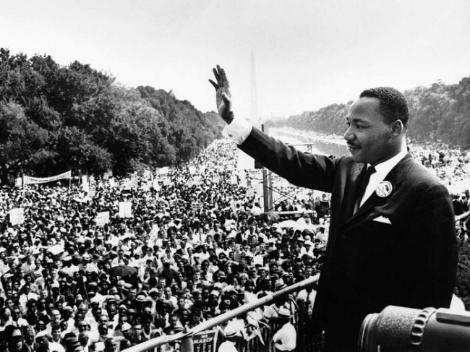

Slide 6
Images
Gathered up hopes of the people
Specific
Clear
Appeal to emotions

Slide 7
Vision
Culture
Prayer and Planning
Leader

