Slide 1
Introduction to Social Media Management

Slide 2
Here’s what we’ll learn…
You’ll understand the basic foundations of Social Media Marketing & Community Management. We’ll be covering:
Best Practices & Methods
Terminology & Lingo
Management Metrics
Management Roles

Slide 3
Best Practices & Methods
The Principles of Well-Executed
Social Media Marketing

Slide 4
THERE ARE FOUR ELEMENTS TO SUCCESSFUL SOCIAL MEDIA MARKETING

Slide 5
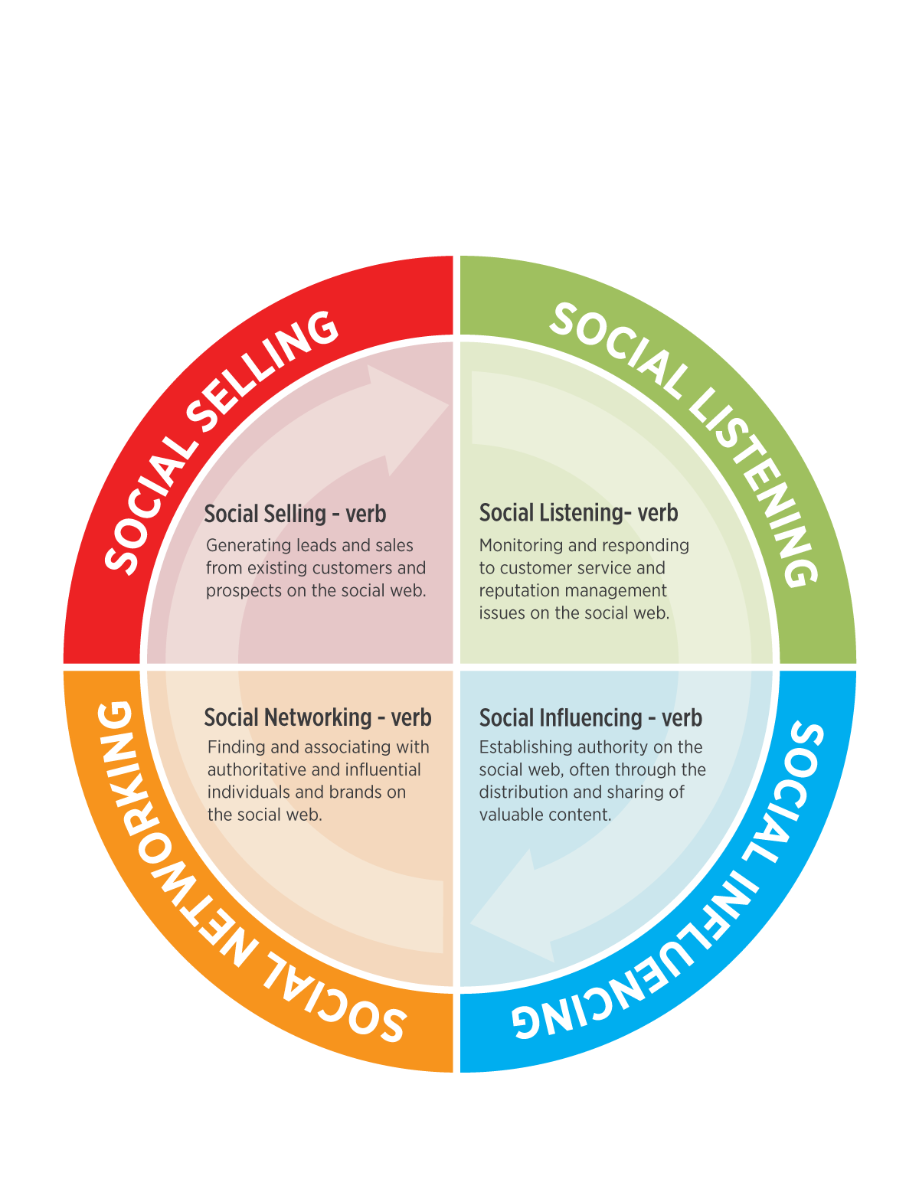

Slide 6
Not answering the social telephone is a huge #FAIL…
Notes:
There are a lot of ways to fail on social media, but the biggest one of all is not answering the social telephone.

Slide 7
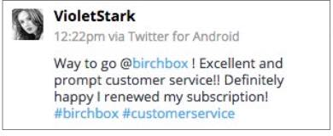
Your customers and your prospects are talking about you on the social web…

Slide 8
SOCIAL LISTENING IS FOUNDATIONAL…

Slide 9
Social Listening informs…
Social Influencing
Social Networking
Social Selling

Slide 10
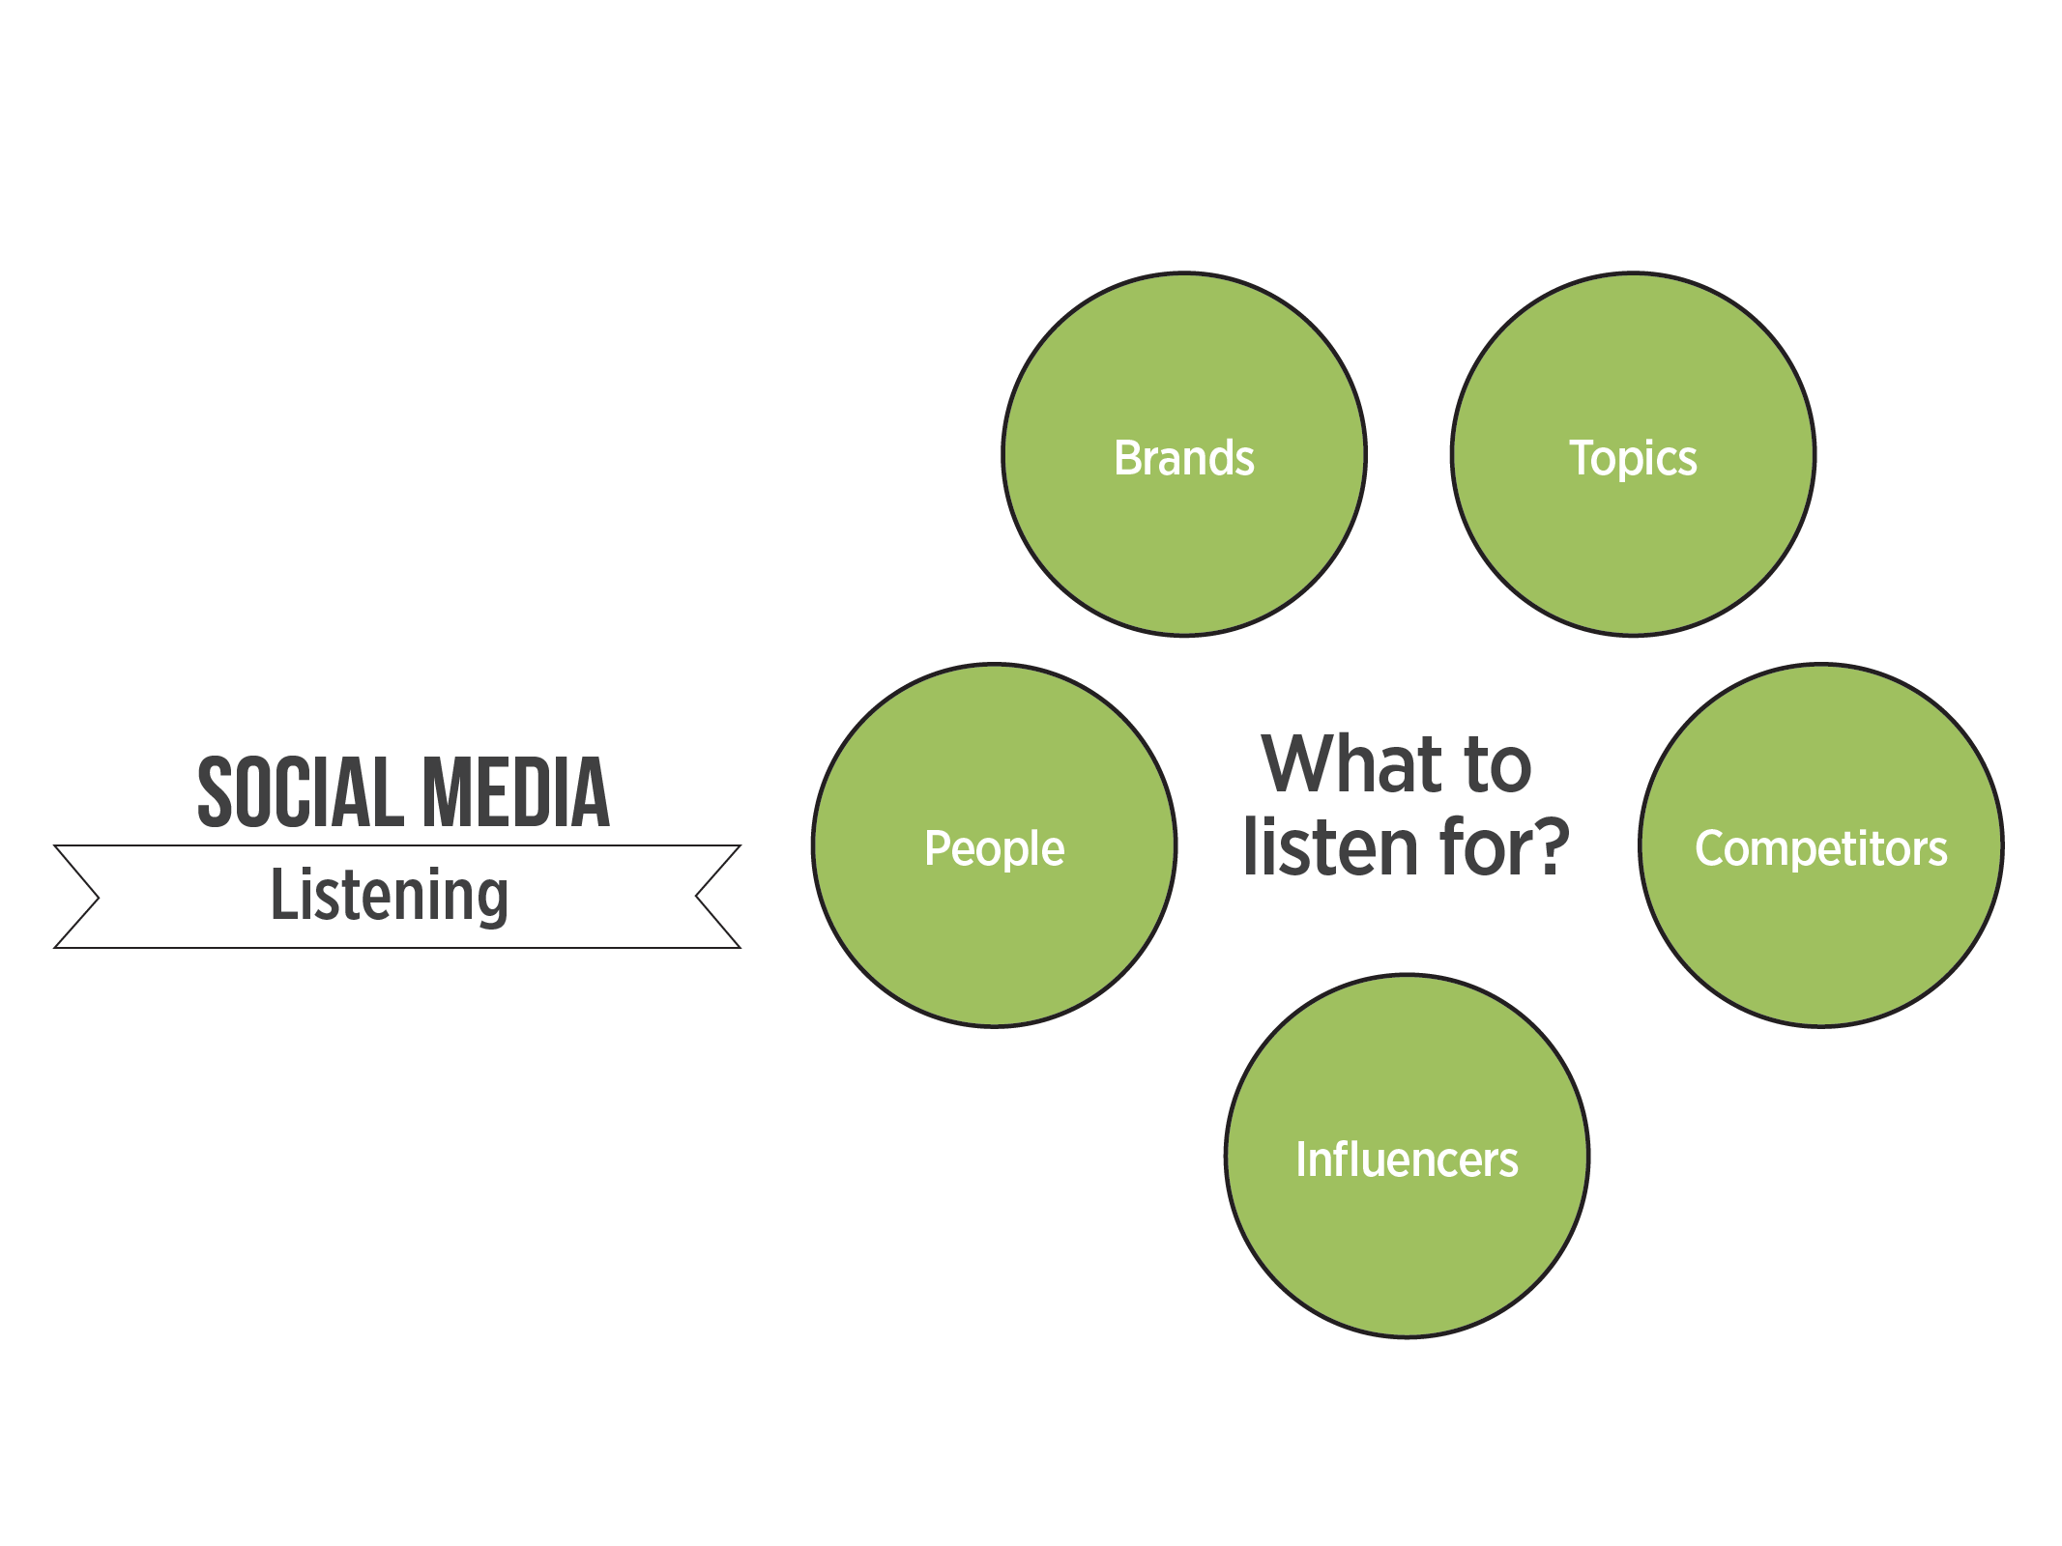

Slide 11
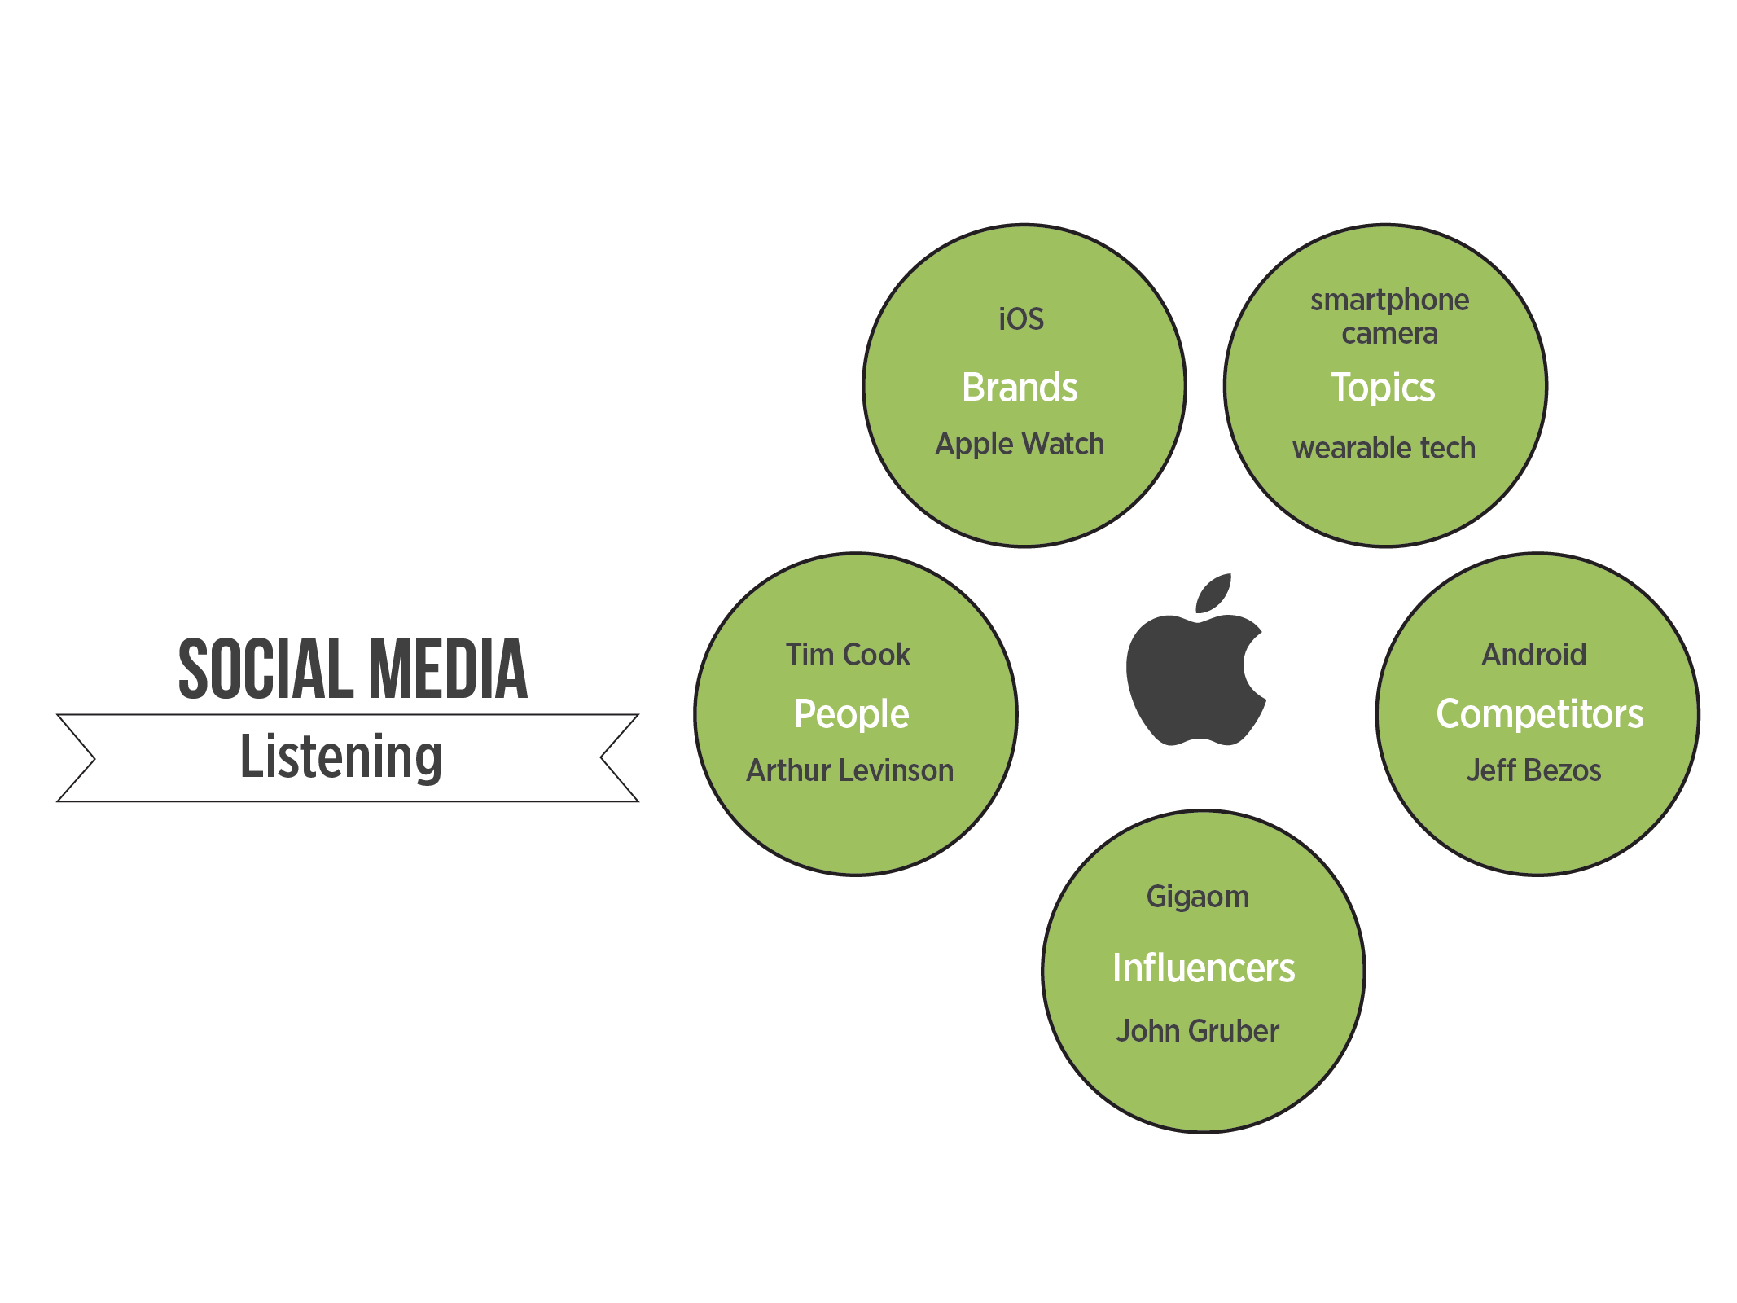

Slide 12
SOCIAL LISTENING GOALS

Slide 13
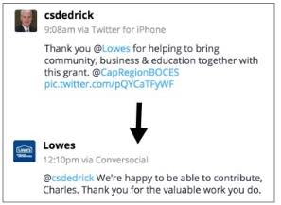
Managing Reputation…

Slide 14
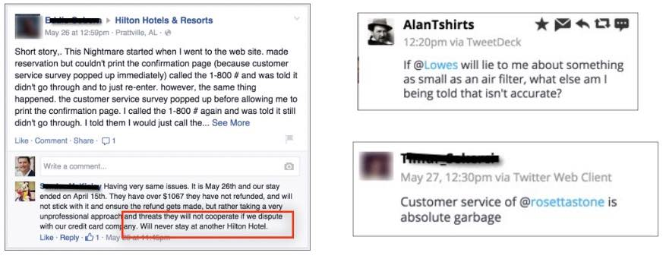
Increase retention / Reduce refunds…

Slide 15
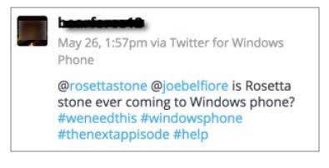
Identify Product / Content Gaps…

Slide 16
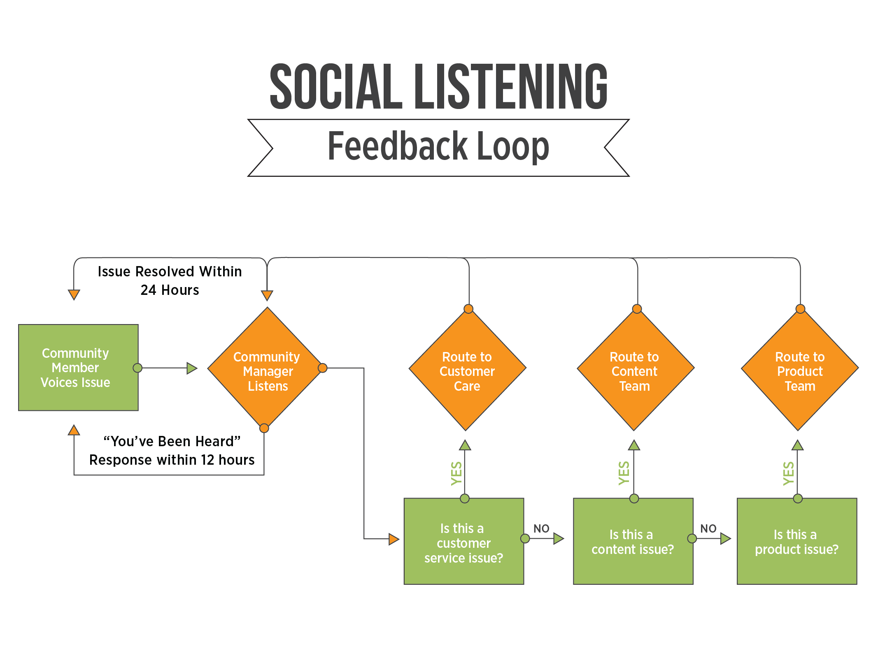

Slide 17
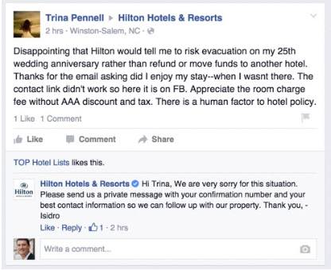
3-Step Social Customer Service Plan…
Respond in a timely manner
Empathize
Move to a private channel

Slide 18
SOCIAL LISTENING METRICS

Slide 19
Reputation score
Retention rate
Refund rate
Product gaps identified
Content gaps identified
You’re measuring…

