Slide 1
Middle and High School
Powerpoint

Slide 2
15

Slide 3
Dialogue for Different Countries

Slide 4
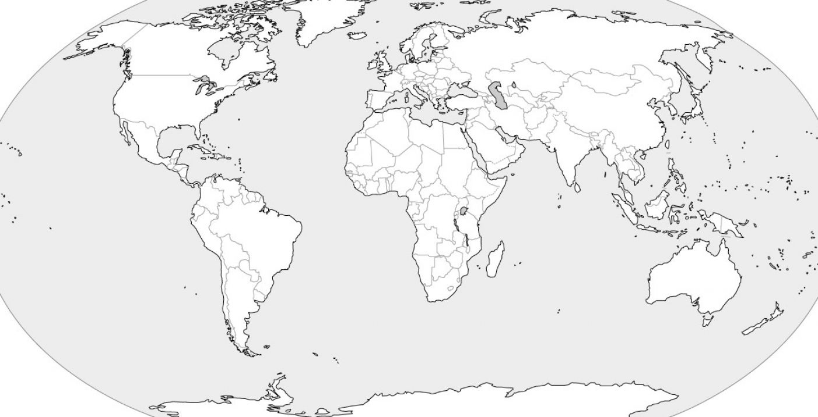
Dialogue for different countries

Slide 5
Different Countries
United States Germany
Canada Egypt
Mexico Spain
France China
England Japan
Italy

Slide 6
Practice 3: Different Dialogue with Family
Cynthia: Hello, My name is Cynthia. What is your name?
Jennifer: My name is Jennifer. Do you live here in the United States?
Cynthia: Yes, I’m from the United States. What country did you come from?
Jennifer: I’m from England. Have you been to England?
Cynthia: No, I haven’t, but I’ve been to Egypt.

Slide 7
Practice 3: Dialogue about countries
Jose: I live in Spain and my brother lives in China.
Joseph: I was a teacher in China, but now I teach in Germany. What kind of work do you do?
Jose: I am a lawyer. I work for a company in Spain. Do you teach children or adults?
Joseph: I teach children in grades 4th and 5th .
Jose: That great!

Slide 8
Writing sentences Practice 3
I am going to Egypt to see the huge pyramids
In Canada many people I know speak French.
My friend Lisa went to Italy to visit her cousin Jack.
I love the beautiful Mountains in Mexico.
The Panda bear is protected from harm in China.
Japan is a small island in the North Pacific Ocean.

Slide 9
Practice 1: Use the vocabulary words to write dialogue sentences on your own.
_________ __________________________________
_________ __________________________________
_________ __________________________________
_________ __________________________________

