Slide 1
Greco/Roman Culture 500 B.C.-1000 A.D.
Two civilizations, various empires, yet in many ways a unified culture
E.g. Koine Greek (grammar), Greek religion/mythology/art; Roman military rule/law/architecture; combination in political administration

Slide 2
Ancient Greece
READING ASSIGNMENT Article entitle Ancient Greece by Joshua Mark found at https://www.ancient.eu/greece/

Slide 3
Little arable land: sea power
Ionia in Asia Minor
POLIS: City States: Athens, Sparta, Corinth, Ephesus, Rhodes

Slide 4
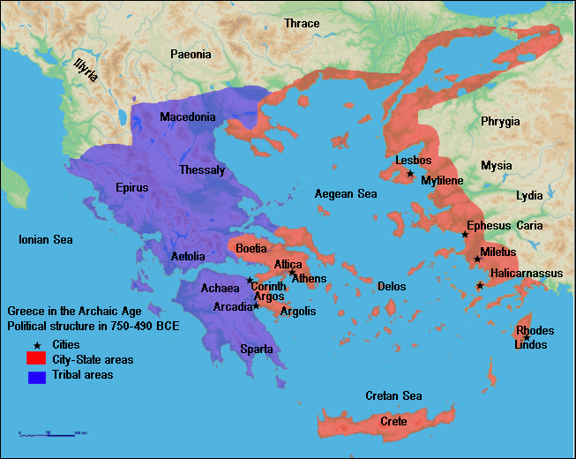
https://upload.wikimedia.org/wikipedia/commons/5/5d/Map_of_Archaic_Greece_(English).jpg

Slide 5
Sparta
Divided society, Helots—slaves and free born military
Free born boys raised communally age 7, to be warriors for Sparta
Constant threat of slave rebellion

Slide 6
https://upload.wikimedia.org/wikipedia/commons/5/5d/Map_of_Archaic_Greece_(English).jpg

Slide 7
Magna Graecia
Greek colonies (600-185 B.C.) especially in Italy and islands, Sicily.
Greek culture, religion, and politics west into Med.

Slide 8
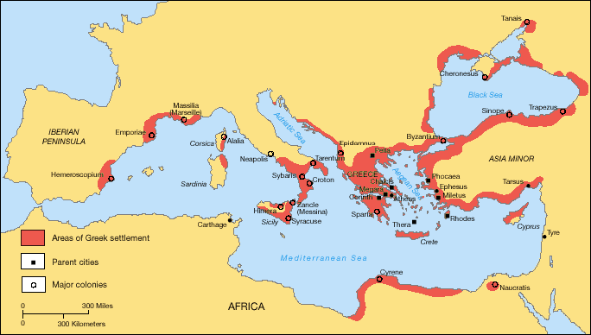
https://upload.wikimedia.org/wikipedia/commons/f/f7/Greek_Colonization_Archaic_Period.png

Slide 9
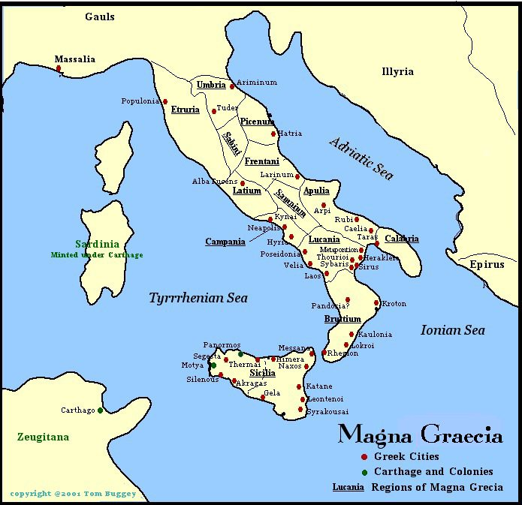
http://tjbuggey.ancients.info/images/maggrecia1.jpg

Slide 10
Leadership in Greek Polis-City States
Leadership: king, or ruler, or general, or tyrant, selected from among the prominent class, sometimes for a specific length of time—or to met specific threat.
Theoretically, every males over 20 with property could vote. Foundations of democracy?

Slide 11
First Among Equals
Not dynastic-generally
Not rule by divine right—nor embodiment of god
Not “worshipped”—First among Equals
Not like Eastern or Egyptian rulers

Slide 12
Classical Greece 500 B.C.-350 B.C.
Persian Wars 490-480 B.C.—with Athens leader of city states; Sparta next
Leagues of Cities
Peloponnesian Wars. The first conflict (c. 460-445 BCE) ended in a stalemate: the second (431-404 BCE) between Sparta and Athens—Sparta destroys Athens, but soon falls too.
Philip of Macedon: 380 B.C.; Son, Alexander

Slide 13
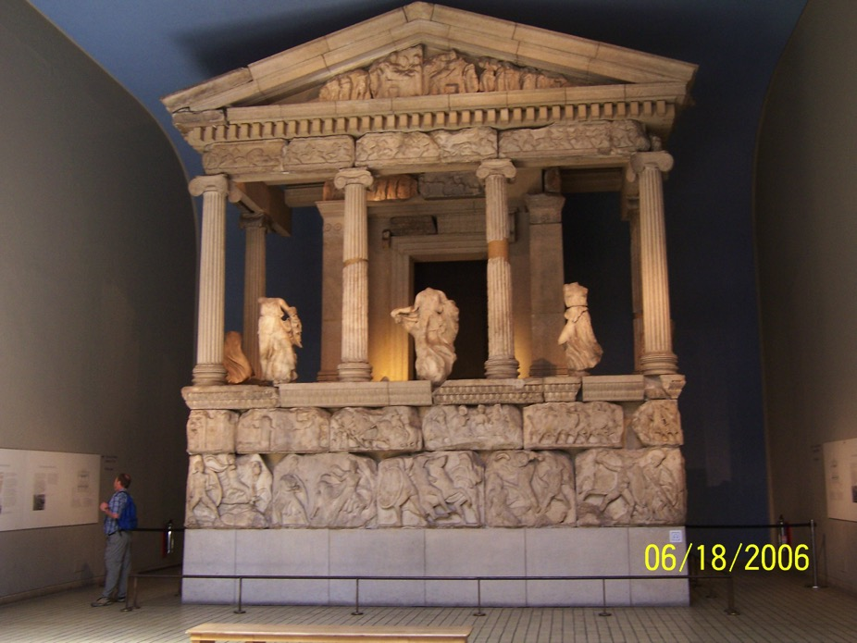

Slide 14
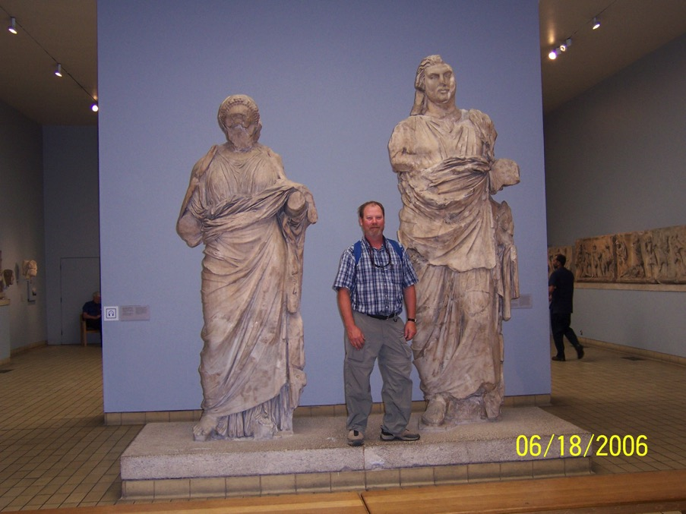

Slide 15
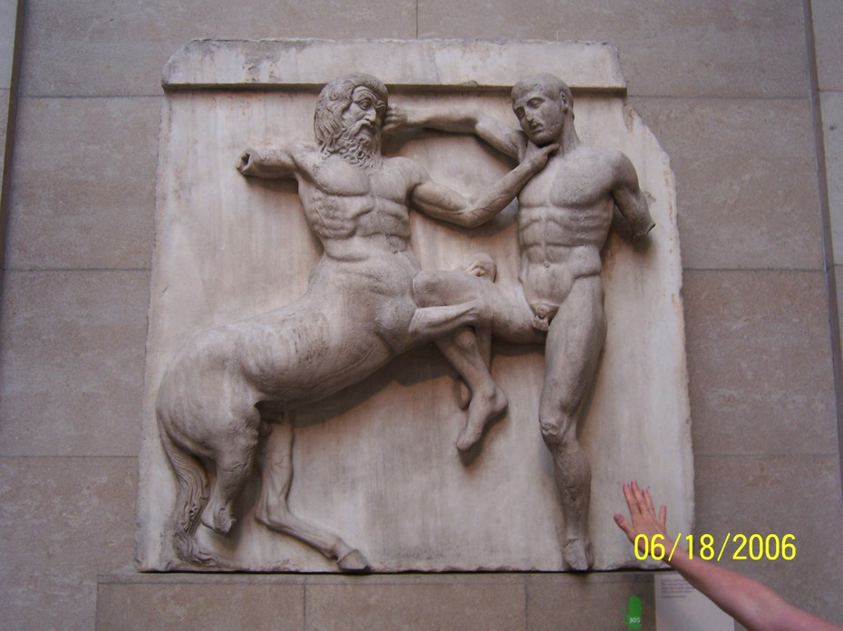

Slide 16
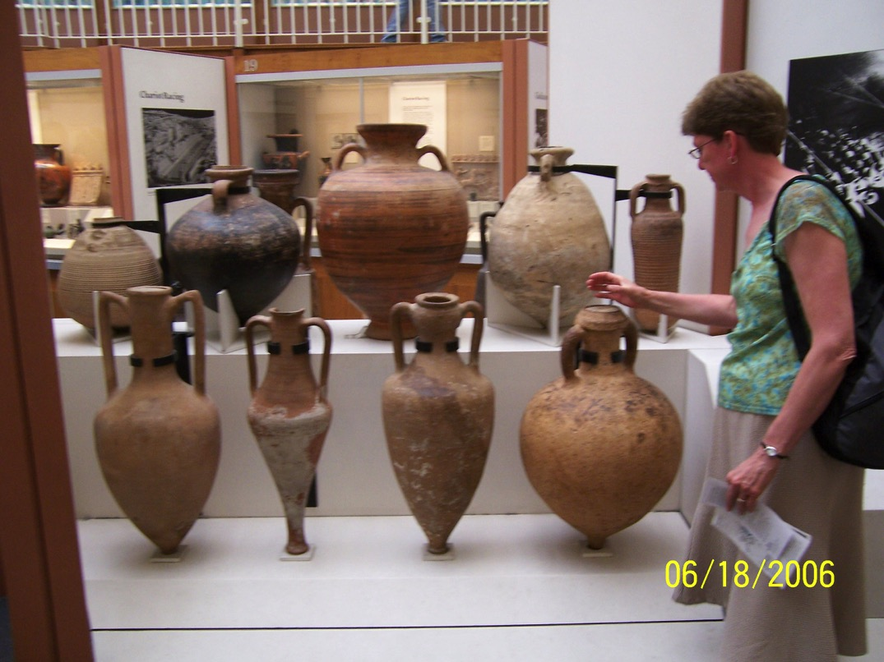

Slide 17
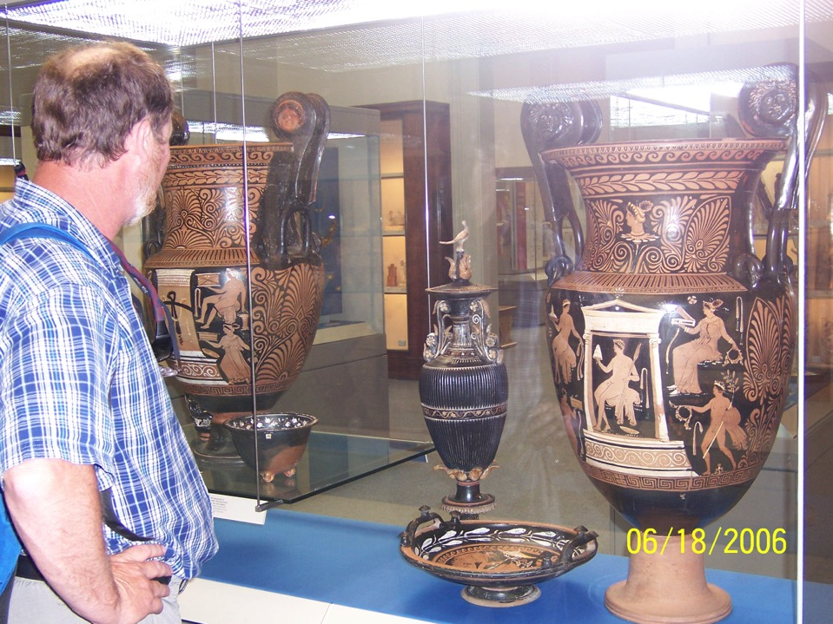

Slide 18
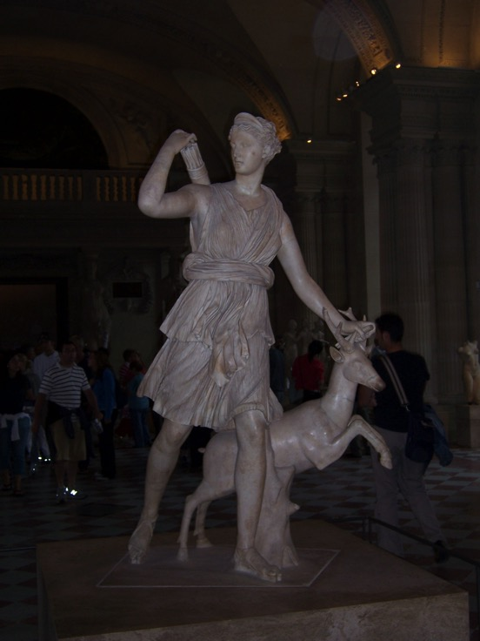

Slide 19
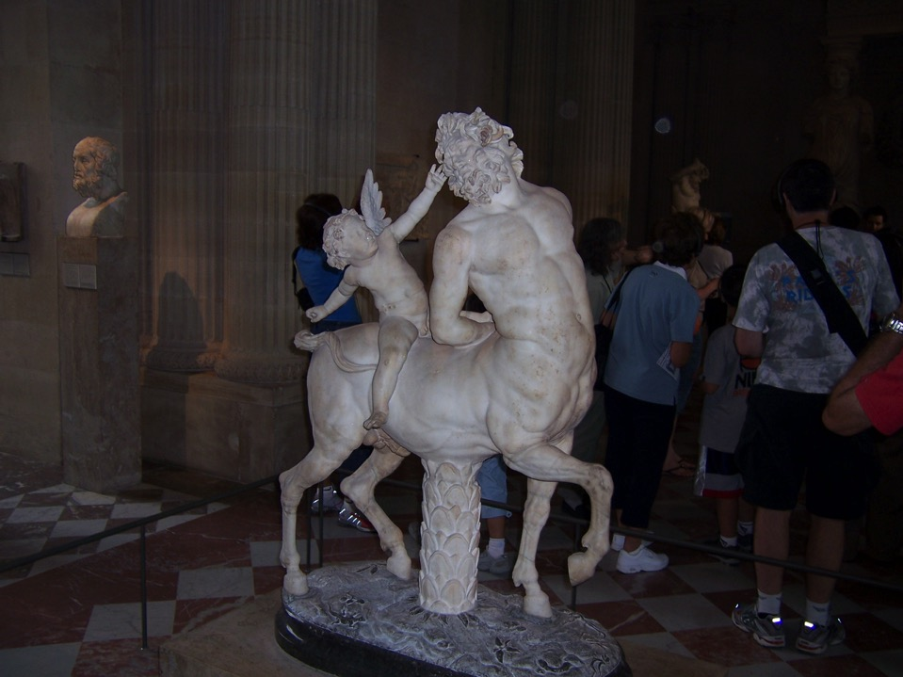

Slide 20
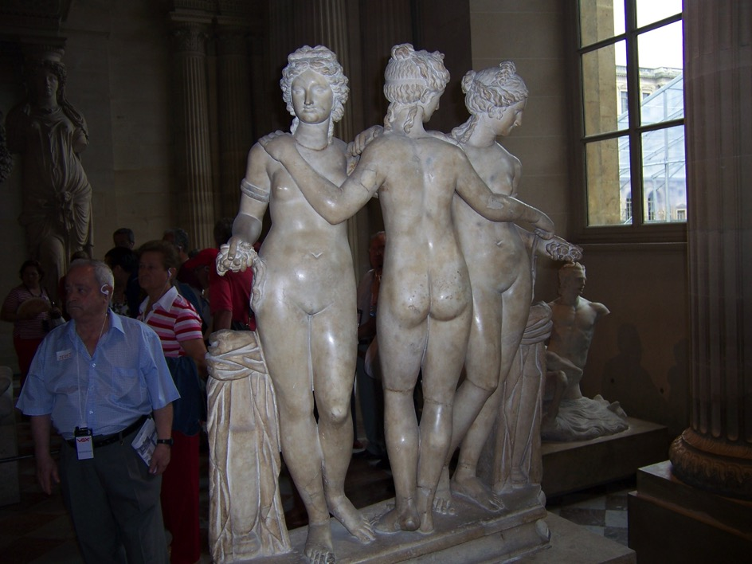

Slide 21
Alexander the Great 336-323 B.C.
Conquers east (Persian and as far as the Indus valley) and south (crowned pharaoh in Egypt--Alexandria)
Educated by Aristotle—one world- “cosmopolitan” : spreads Hellenistic culture wherever he goes; cities settled by veterans.

Slide 22
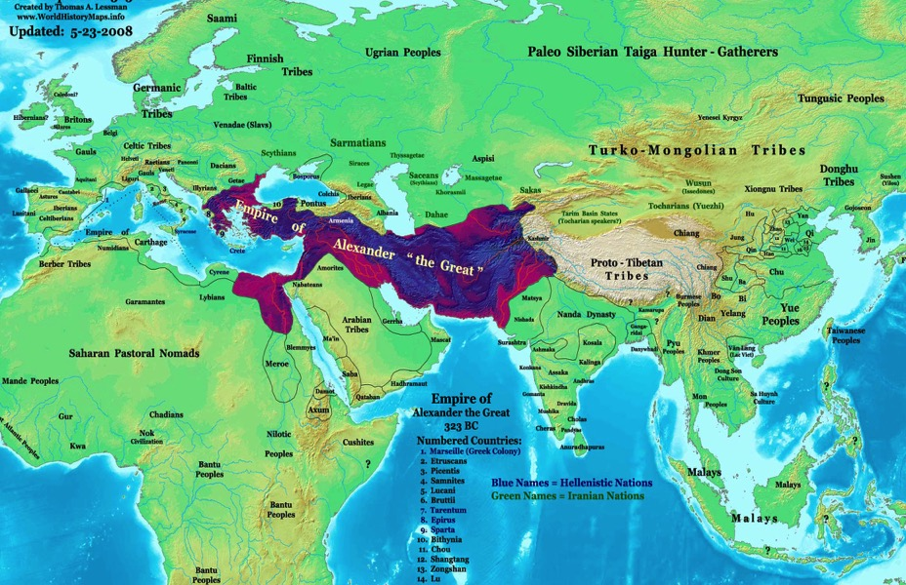
https://upload.wikimedia.org/wikipedia/commons/6/6a/Alexander-Empire_323bc.jpg
https://upload.wikimedia.org/wikipedia/commons/6/6a/Alexander-Empire_323bc.jpg

Slide 23
Claims to be descended from Zeus---in Egypt proclaimed to be Zeus-Ammon’s son.
Hybrid of Eastern and Western leadership
One culture, many nations…unified Greek empire and culture---Hellenistic

Slide 24
Hellenistic Culture
Reading Assignment: Article entitled Hellenistic Period by Antonie Simonin found at https://www.ancient.eu/Hellenistic_Period

Slide 25
Hellenistic World 323-30 B.C.
Koine Greek/gym/bath/theater/stoa/gods
Empire splits into four/three smaller kingdoms:
Antigonid in Greece
Ptolemaic in Egypt
Seleucids in Middle East and India

Slide 26
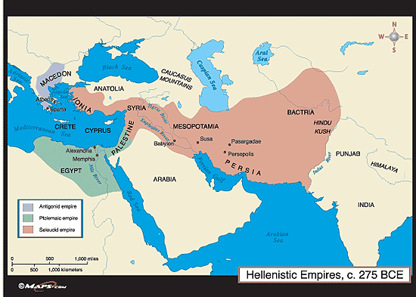
http://chapter9greeceperiod5.weebly.com/uploads/8/9/3/9/8939164/4775247_orig.gif

Slide 27
Rome
READING ASSIGNMENT Articles entitled Ancient Rome by Joshua Mark, found at http://www.ancient.eu/Rome/ and The Roman Empire found at http://www.ancient.eu/Roman_Empire/

Slide 28
Early Rome
750-509 B.C.; on Tiber River; trading post;
Etruscan culture to north, borrowed considerably…Greeks in south and east, borrowed considerably…
Monarchy…

Slide 29
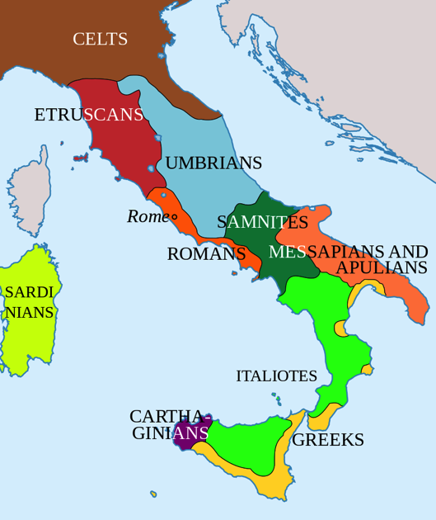
https://upload.wikimedia.org/wikipedia/commons/thumb/b/b5/Italy_400bC_en.svg/859px-Italy_400bC_en.svg.png

Slide 30
Roman Republic
509-27 B.C.
Expanded from Rome through warfare: rest of Italian peninsula, Spain
Carthage—Punic Wars– 246-146 B.C….Rome eventual victor, assumed sea control of western Med.

Slide 31
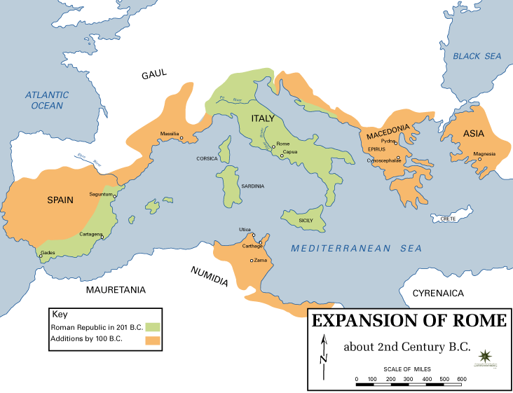
https://upload.wikimedia.org/wikipedia/commons/6/62/Expansion_of_Rome,_2nd_century_BC.gif

