Slide 1
Preacher, Preparation,
Presentation
A class on making and preaching sermons

Slide 2
Introductions
Of Myself

Slide 3
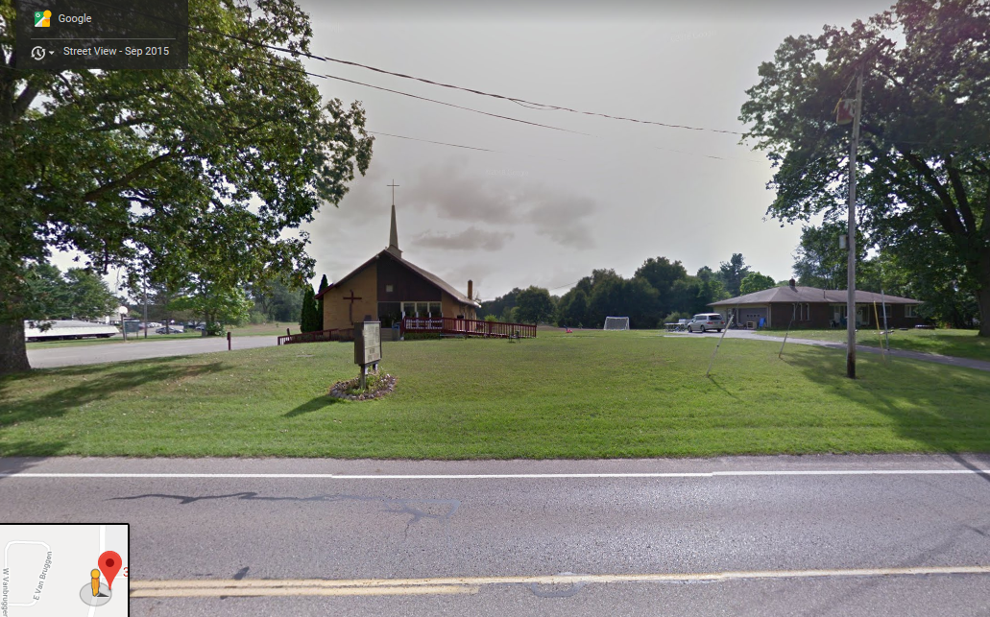
Calvary Church
Plainwell, MI

Slide 4
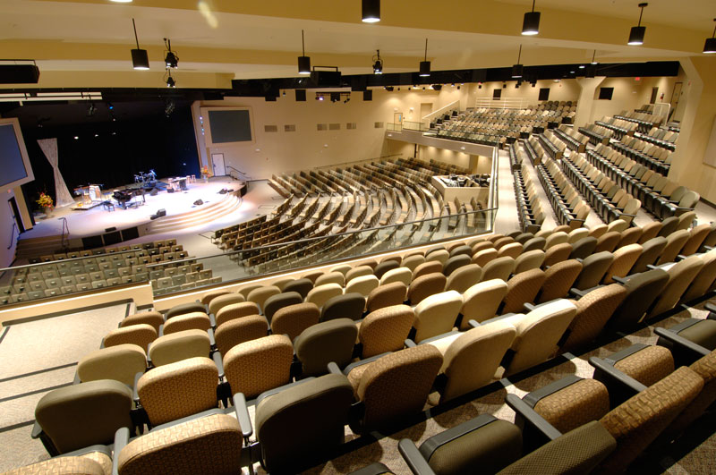
Crosspoint Church, Chino, CA

Slide 6
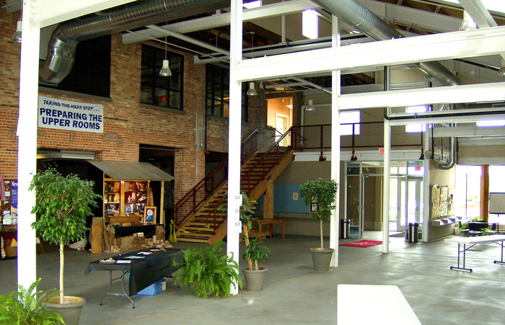

Slide 7
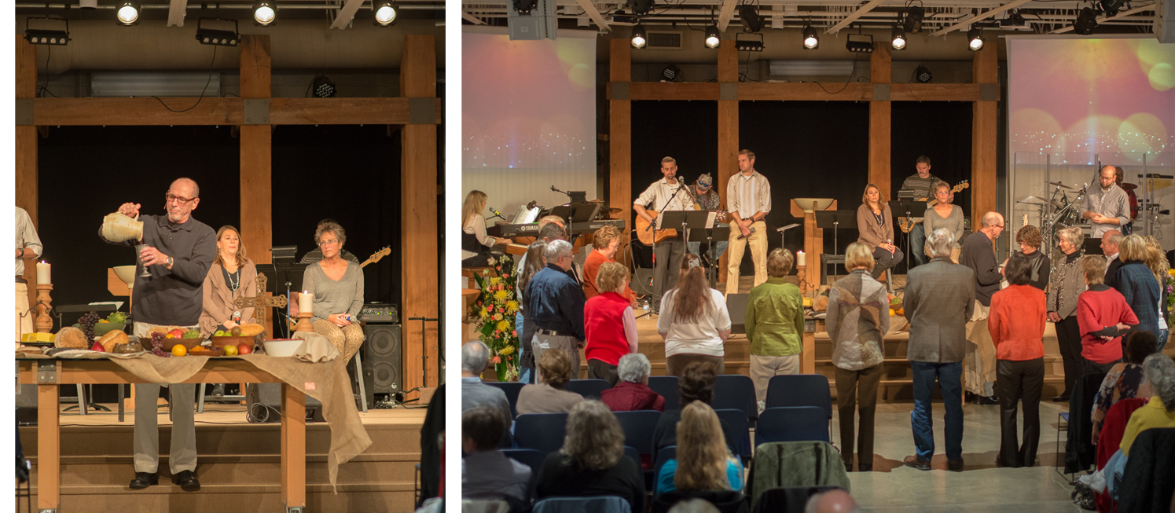
Covenant Life Church
Grand Haven, MI

Slide 8
Introductions
Of Myself
Of the Course

Slide 9
What is preaching?
Various kinds of sermons

Slide 10
What is preaching?
How to prepare for preaching
Prayer
Study of the Bible

Slide 11
What is preaching?
How to prepare for preaching
Construction of a sermon.
Introduction
Points
Conclusions

Slide 12
What is preaching?
How to prepare for preaching
Construction of a sermon.
How to Present a sermon
Illustrations
Gestures

Slide 13
Preacher, Preparation,
Presentation
A class on making and preaching sermons

