Slide 1
7 Housing What kinds of houses did they live in?

Slide 2
House vs. hall, etc.
Mediterranean pattern of design with
central courtyard

Slide 3
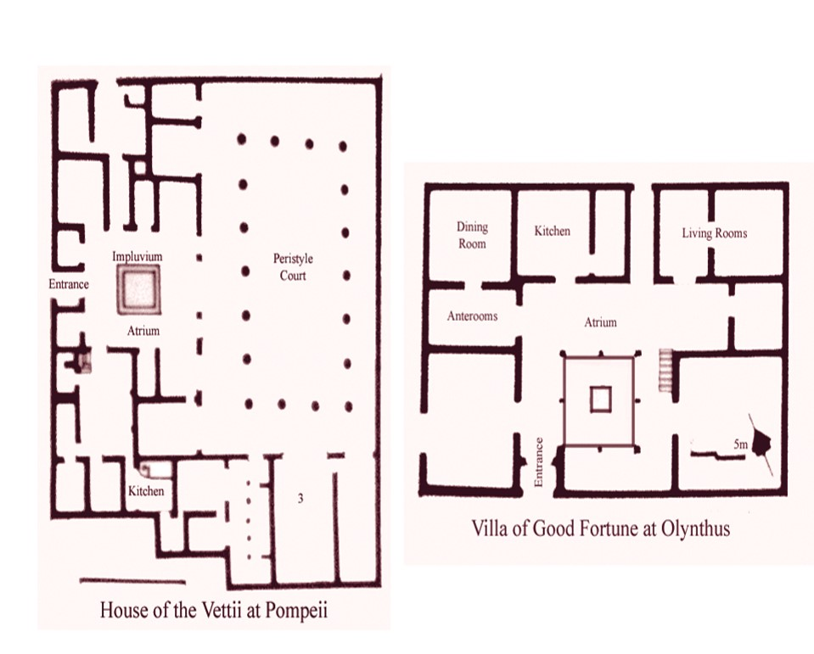

Slide 5
Two luxurious Pompeii houses

Slide 6
Ostia “prefabs”

Slide 7
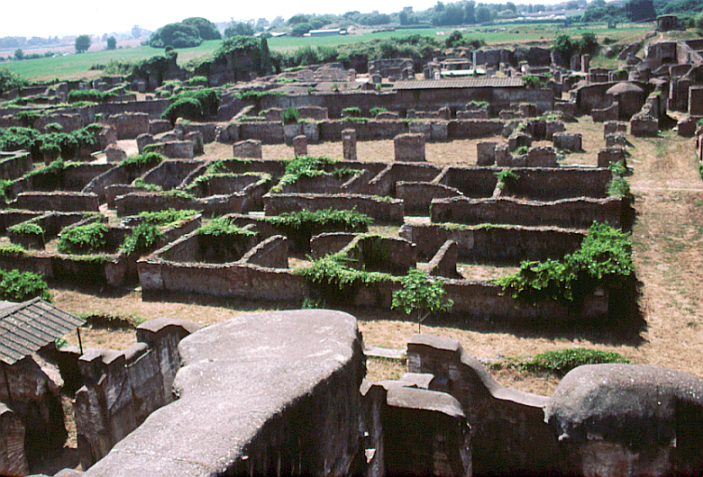

Slide 8
Examples of “insulae” in Ostia and Rome

Slide 9
House of Diana, Ostia

Slide 10
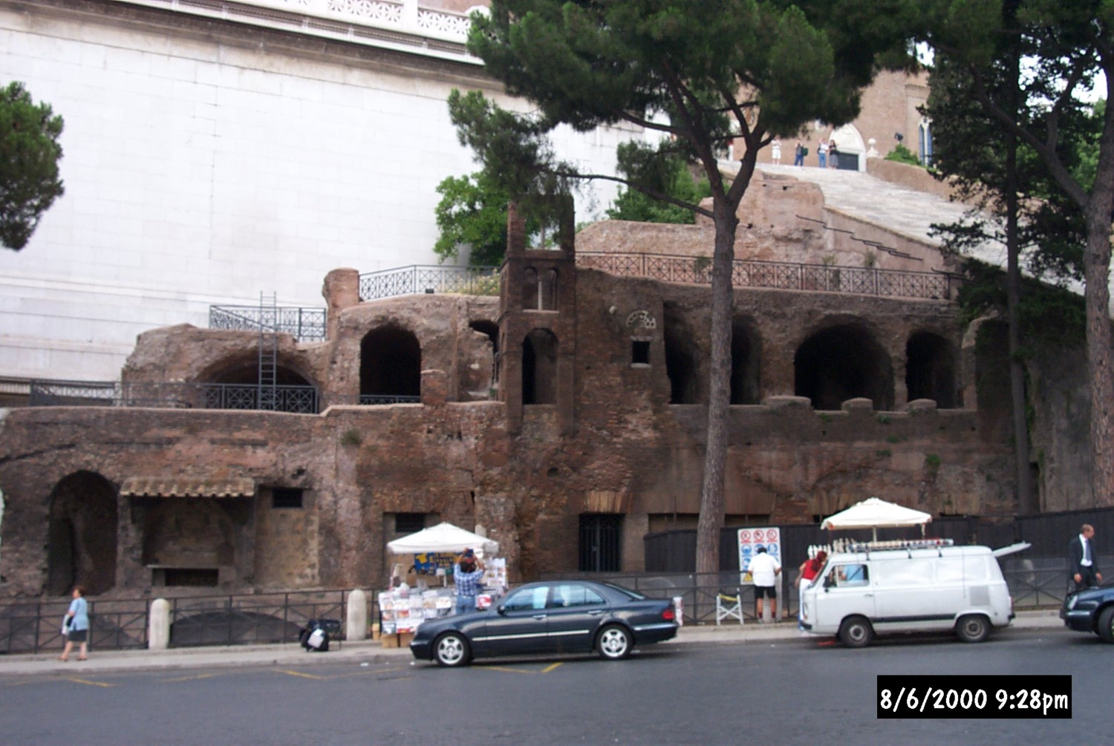
Insula in Rome

