Slide 1
Leadership 17
Developing a Vision

Slide 2
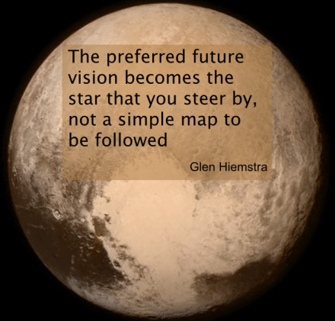
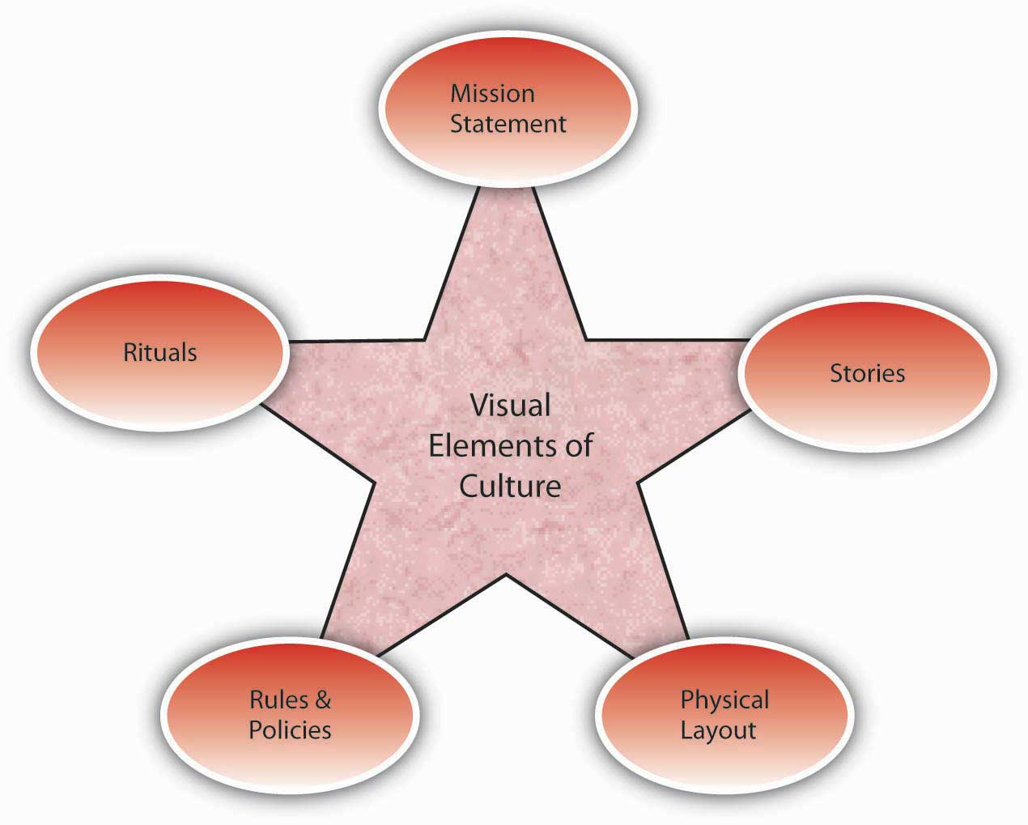
Vision
Culture
Prayer and Planning
Leader

Slide 4
Birthing a Vision

Slide 5
Birthing a Vision
Who Does It?

Slide 6
Birthing a Vision
Who Does It?
The Leader?

Slide 7
Birthing a Vision
Who Does It?
The Leader
e.g. of SNL
Must know yourself
Must know your context
Must know God
Must know good advice

Slide 8
Birthing a Vision
Who Does It?
The Leader?
Must know yourself
Must know your context
Must know God
Must know good advice
Significant Others

Slide 9
Historians tend to write about great leaders, as if they were capable of creating their visions and sense of destiny out of some mysterious inner source. Perhaps some do, but upon closer examination it usually turns out that the vision did not originate with the leader personally, but rather from others.
Bennis and Nanus, Leaders, p. 95

Slide 10
Birthing a Vision
Who Does It?
The Process

Slide 11
Birthing a Vision
Who Does It?
The Process
Gestation Period
Untapped Opportunities
Dissatisfaction with status quo

Slide 12
Birthing a Vision
Who Does It?
The Process
Gestation Phase
Growing Phase
Visions expand as viable alternatives are explored.
Leaders vs. critics

Slide 13
Birthing a Vision
Who Does It?
The Process
Gestation Phase
Growing Phase
Visions expand as viable alternatives are explored.
Leaders vs. critics
Investigation

Slide 14
Birthing a Vision
Who Does It?
The Process
Gestation Phase
Growing Phase
Development Phase
Prayer
Thinking big
Putting it on paper

Slide 15
Prayer
Where God calls, the “how”
is not a concern.
e.g. of Abraham
e.g. of Moses
e.g. of Jericho
e.g. of Mary
e.g. of Nehemiah
Good ideas vs. God ideas

Slide 16
How will you find the women?
to be mentored
to mentor?
How will you train the mentors?
How long will the program last?
Who’s in charge?
How will you pair the women up?
What curriculum will you use?

Slide 17
Birthing a Vision
Who Does It?
The Process
Gestation Phase
Growing Phase
Development Phase
Prayer
Thinking big
Putting it on paper

Slide 18
Thinking Big
e.g. of Nehemiah
Hebrews 11

Slide 19
Birthing a Vision
Who Does It?
The Process
Gestation Phase
Growing Phase
Development Phase
Questioning Phase

Slide 20
Is it culturally relevant?
Is it clear?
Is it compelling?
Is it future-oriented? How long
If your vision is for a year, plant wheat
If your vision is for ten years, plant trees
If your vision is for a lifetime, plant people
Is it realistic, yet stretching?

Slide 21
Birthing a Vision
Who Does It?
The Process
Initiation Phase
Expansion Phase
Development Phase
Questioning Phase
Patience Phase

