Slide 1
Content marketing in a nutshell

Slide 2
Here’s what to expect…
When you finish this module you’ll understand the foundations of Content Marketing. We’ll be covering:
The Content Marketing Method
Content Marketing Lingo
Content Marketing Metrics
Content Marketing Roles
How to get more training on Content Marketing

Slide 3
BUSINESS OWNERS ONLY CARE ABOUT REVENUES AND COSTS

Slide 4
CONTENT MARKETING IS THE INTERSECTION OF ADVERTISING AND PUBLISHING

Slide 5
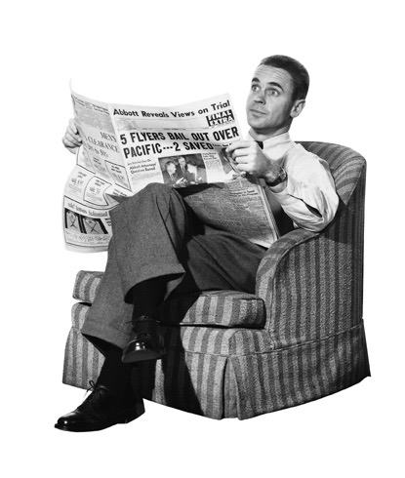
Content
Advertising

Slide 6
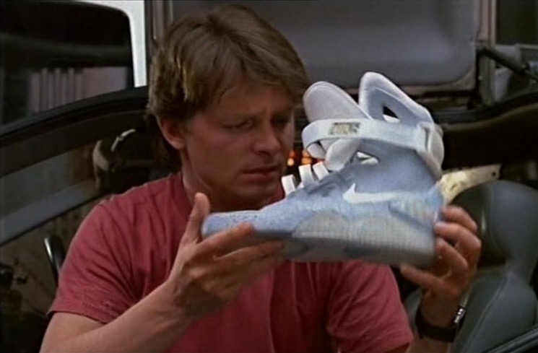
Content
Advertising

Slide 7
Content
Advertising

Slide 8
McDonald’s is a Hamburger Company…

Slide 9
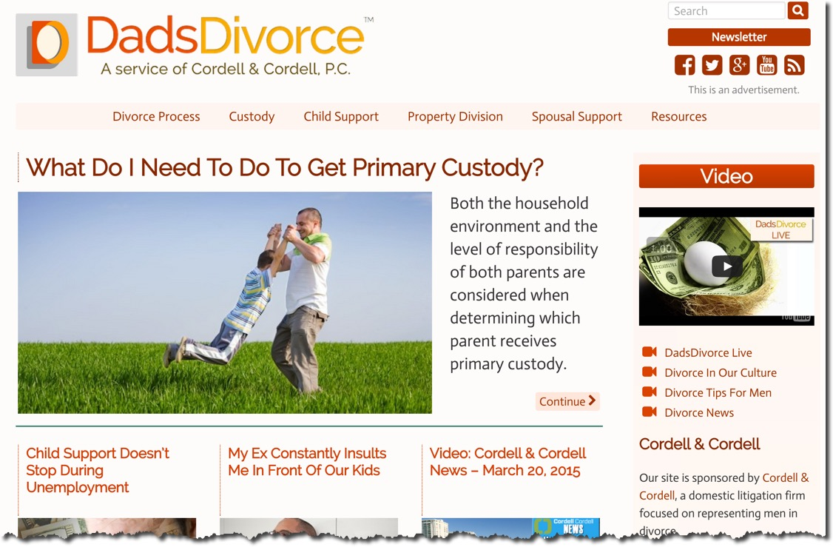
Cordell & Cordell is a Family Attorney firm…

Slide 10
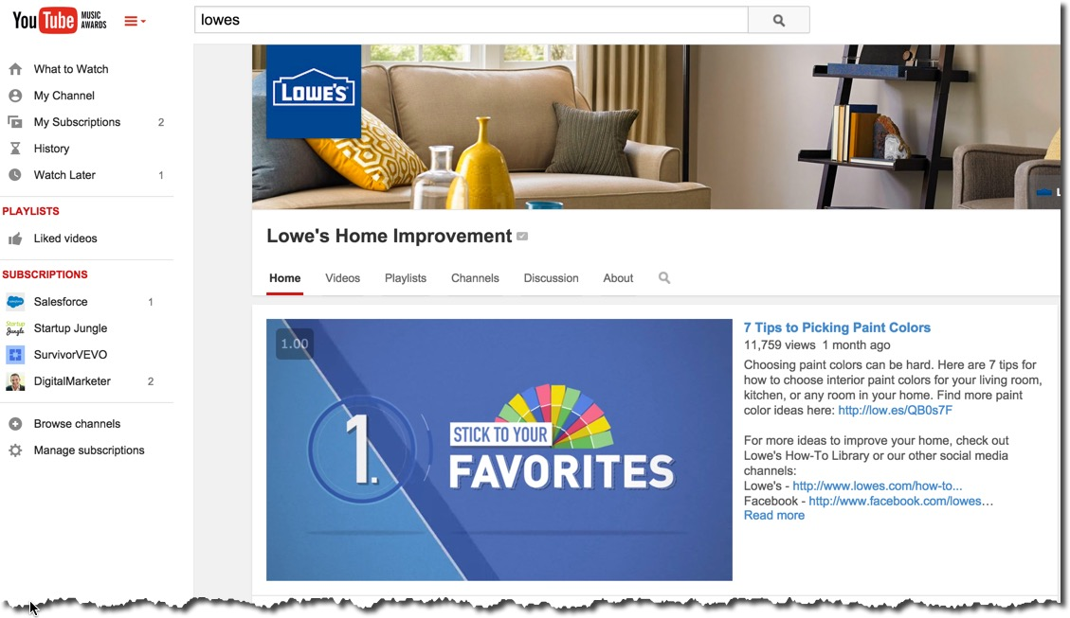
Lowe’s is a Home Improvement Company…

Slide 11
… BUT THEY ARE ALL MEDIA COMPANIES.

Slide 12
“Media is anything that aggregates the attention of a definable market segment into a specific location
at a predictable time.”

Slide 13
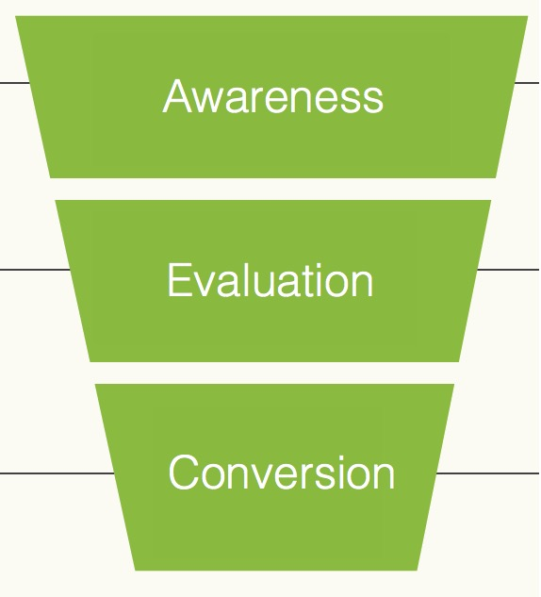
A simple marketing funnel…

Slide 14
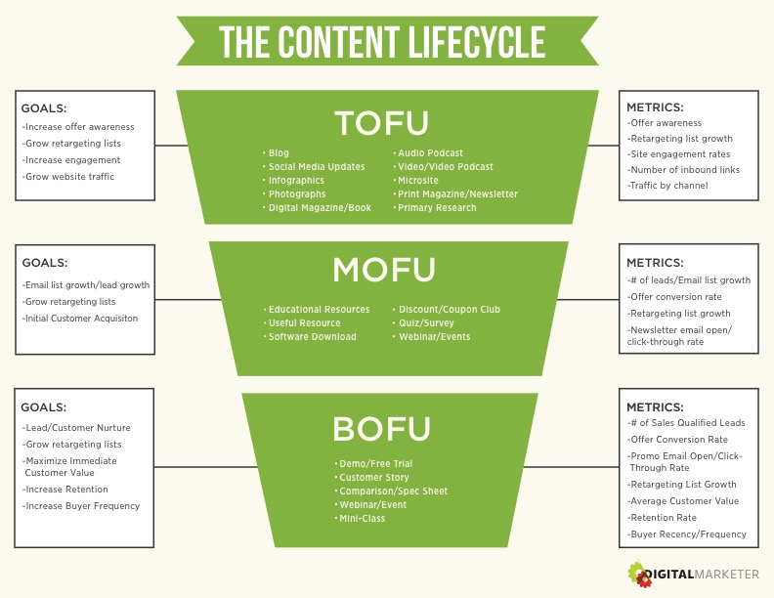
Translates to this in content marketing…

Slide 15
THE GOAL AT THE TOP OF THE FUNNEL IS TO
RAISE AWARENESS

