Slide 1
Political and Social Life 1000-1500
China
Europe

Slide 2
China
Song Dynasty (northern 960-1127, Southern 1127-1279)
Shenzong (reigned 1067–85) …. Shenzong responded vigorously (and rather unexpectedly, from the standpoint of many bureaucrats) to the problems troubling the established order, some of which were approaching crisis proportions. Keeping above partisan politics, he made the scholar-poet Wang Anshi his chief councillor and gave him full backing to make sweeping reforms. Known as the New Laws, or New Policies, these reform measures attempted drastic institutional changes. ….

Slide 3
The government squarely faced the reality of a rapidly spreading money economy by increasing the supply of currency. The state became involved in trading, buying specific products of one area for resale elsewhere (thereby facilitating the exchange of goods), stabilizing prices whenever and wherever necessary, and making a profit itself. This did not displace private trading activities. On the contrary, the government extended loans to small urban and regional traders through state pawnshops—a practice somewhat like modern government banking but unheard-of at the time. Far more important, if not controversial, the government made loans at the interest rate, low for the period, of 20 percent to the whole peasantry during the sowing season, thus assuring their farming productivity and undercutting their dependency upon usurious loans from the well-to-do. The government also maintained granaries in various cities to ensure adequate supplies on hand in case of emergency need. The burden on wealthy and poor alike was made more equitable by a graduated tax scale based on a reassessment of the size and the productivity of the landholdings. Similarly, compulsory labour was converted to a system of graduated tax payments, which were used to finance a hired-labour service program that at least theoretically controlled underemployment in farming areas. Requisition of various supplies from guilds was also replaced by cash assessments, with which the government was to buy what it needed at a fair price.

Slide 4
The magnitude of the reform program was matched only by the bitter opposition to it. Determined criticism came from the groups hurt by the reform measures: large landowners, big merchants, and moneylenders…..
Without directly attacking the emperor, the critics attacked the reformers for deviating from orthodox Confucianism.
www.britannica.com/place/China/Foreign-affairs-under-Yangdi

Slide 5
Yuan Dynasty
Descendants of Genghis Khan –Kublai Khan
Military conquest
Tried to govern as Chinese:
“1260s the central bureaucracy and the local administration of the Chinese empire were remodeled on Chinese lines, with certain alterations introduced by the Jin state. ”
https://www.britannica.com/place/China/Changes-under-Kublai-Khan-and-his-successors

Slide 6
But in other ways were clearly foreign system:
“The unwillingness of the Mongols to assimilate with the Chinese is shown by their attempts to cement the inequalities of their rule. After the Song empire had been conquered, the population of China was divided into four classes. The first class was the Mongols themselves, a tiny but privileged minority. Next came the semuren (“persons with special status”), confederates of the Mongols such as Turks or Middle Eastern Muslims. The third group was called the hanren (a term that generally means Chinese but that was used to designate the inhabitants of only northern China); this class included the Chinese and other ethnic groups living in the former Jin state, as well as Xi Xia, Juchen, Khitan, Koreans, Bohai, and Tangut, who could be employed in some functions and who also formed military units under Mongol leadership.

Slide 7
The last group was the nanren, or manzi, pejorative terms in Chinese, meaning “southern barbarian,” which designated the former subjects of Song China (about three-fourths of the Chinese empire). The lowest stratum in Yuan China was occupied by the slaves, whose numbers were quite considerable. Slave status was hereditary, and only under certain conditions could a slave be freed.

Slide 8
More than four-fifths of the taxpayers came from the nanren group, which was generally barred from holding higher office (only rarely would one of them rise to some prominence). The Mongols and the semuren were tax-exempt and enjoyed the protection of the law to a higher degree than did the hanren and nanren.” https://www.britannica.com/place/China/Changes-under-Kublai-Khan-and-his-successors

Slide 9
As has been mentioned, Mongol rulers favoured trade in all their dominions. In China too they eliminated state trade controls that had existed under the Song and Jin, so that internal and external trade reached unprecedented proportions. It seems, however, that China’s transcontinental trade with the Middle East and Europe was in the hands of non-Chinese (mainly Persians, Arabs, and Syrians). Silk, the Chinese export commodity par excellence, reached the Middle East and even Europe via the caravan routes across Asia; Chinese ceramics were also exported, chiefly into the Islamic countries. The Asian countries concentrated their European trade largely with the Italian republics (e.g., Genoa, Venice). To the Italians, trade with the East was so important that the Practica della mercatura, a handbook on foreign trade, included the description of trade routes to China.
https://www.britannica.com/place/China/Changes-under-Kublai-Khan-and-his-successors

Slide 10
Yuan decline
Fractured into independent like states, Yuan not truly Chinese..
Era of Marco Polo, published account of years of travel and trade in China---”best seller” in Europe.

Slide 11
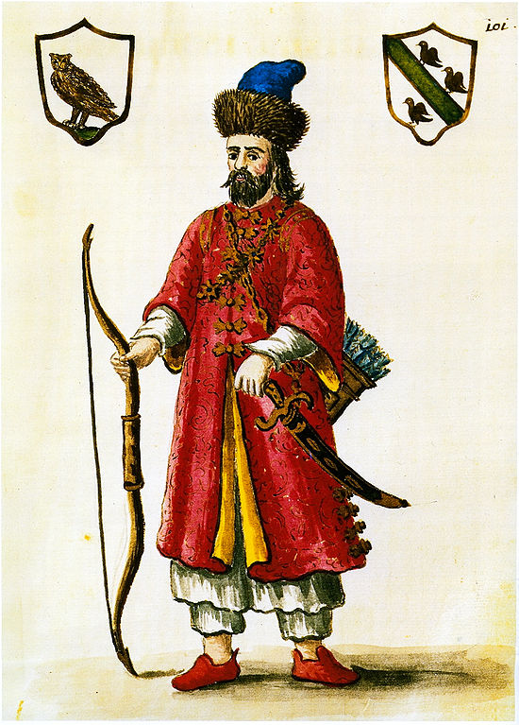
https://upload.wikimedia.org/wikipedia/
commons/thumb/3/3d/Marco_Polo_-_costume
_tartare.jpg/550px-Marco_Polo
_-_costume_tartare.jpg

Slide 12
Ming Dynasty 1368-1644
The Ming dynasty, which encompassed the reigns of 16 emperors, proved to be one of the stablest and longest ruling periods of Chinese history. Rulers of Korea, Mongolia, East Turkistan, Myanmar, Siam, and Nam Viet regularly acknowledged Ming overlordship, and at times tribute was received from as far away as Japan, Java and Sumatra, Sri Lanka and South India, the East African coast, the Persian Gulf region, and Samarkand. Modern Chinese honour the Ming emperors especially for having restored China’s international power and prestige, which had been in decline since the 8th century. The Ming emperors probably exercised more far-reaching influence in East Asia than any other native rulers of China, and their attitude toward the representatives of Portugal, Spain, Russia, Britain, and Holland who appeared in China before the end of their dynasty was a condescending one. https://www.britannica.com/place/China/Changes-under-Kublai-Khan-and-his-successors

Slide 13
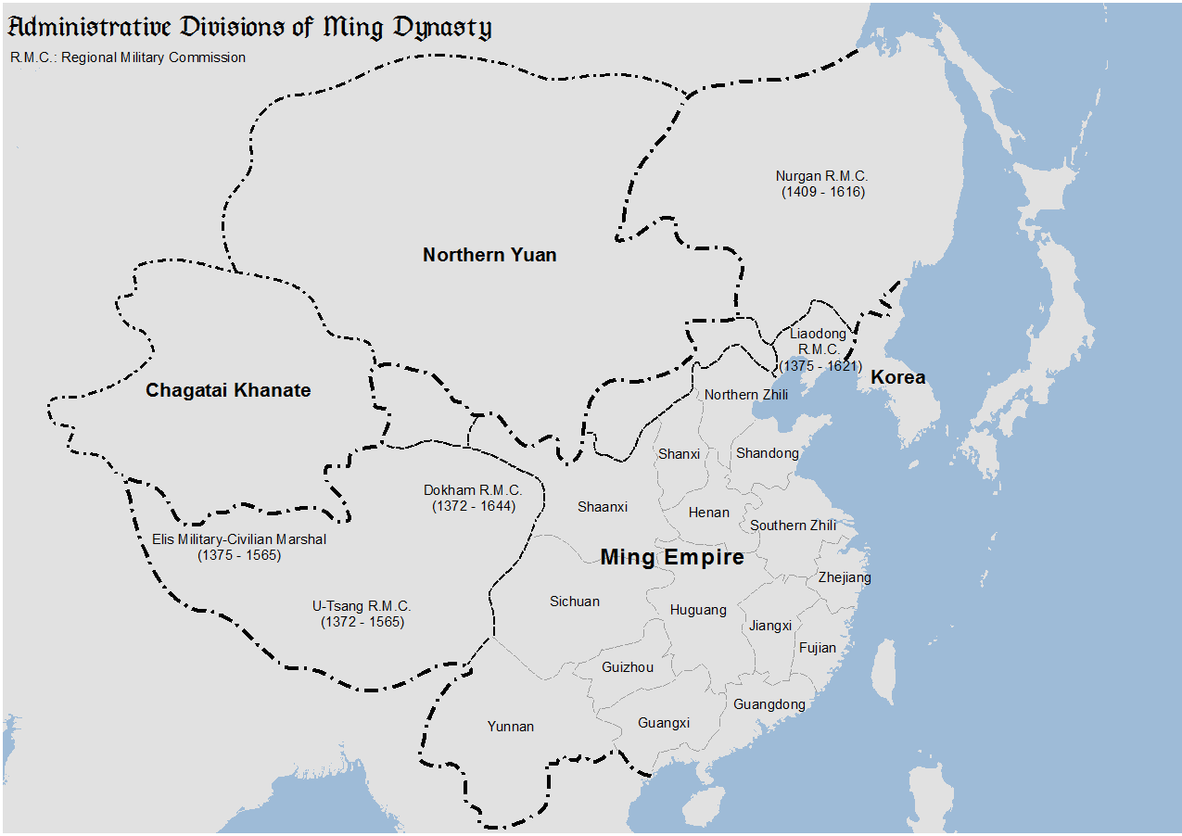
https://upload.wikimedia.org/wikipedia/commons/e/e4/Ming_divisions.png
https://upload.wikimedia.org/wikipedia/commons/e/e4/Ming_divisions.png

Slide 14
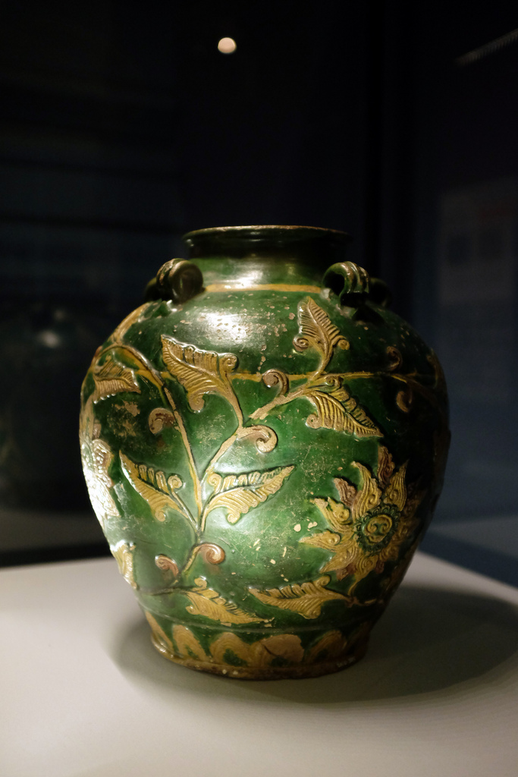
https://c1.staticflickr.com
/3/2865/11264970784_ee
6bd0cba2_b.jpg

Slide 15
Western Europe move toward Nation States

Slide 16
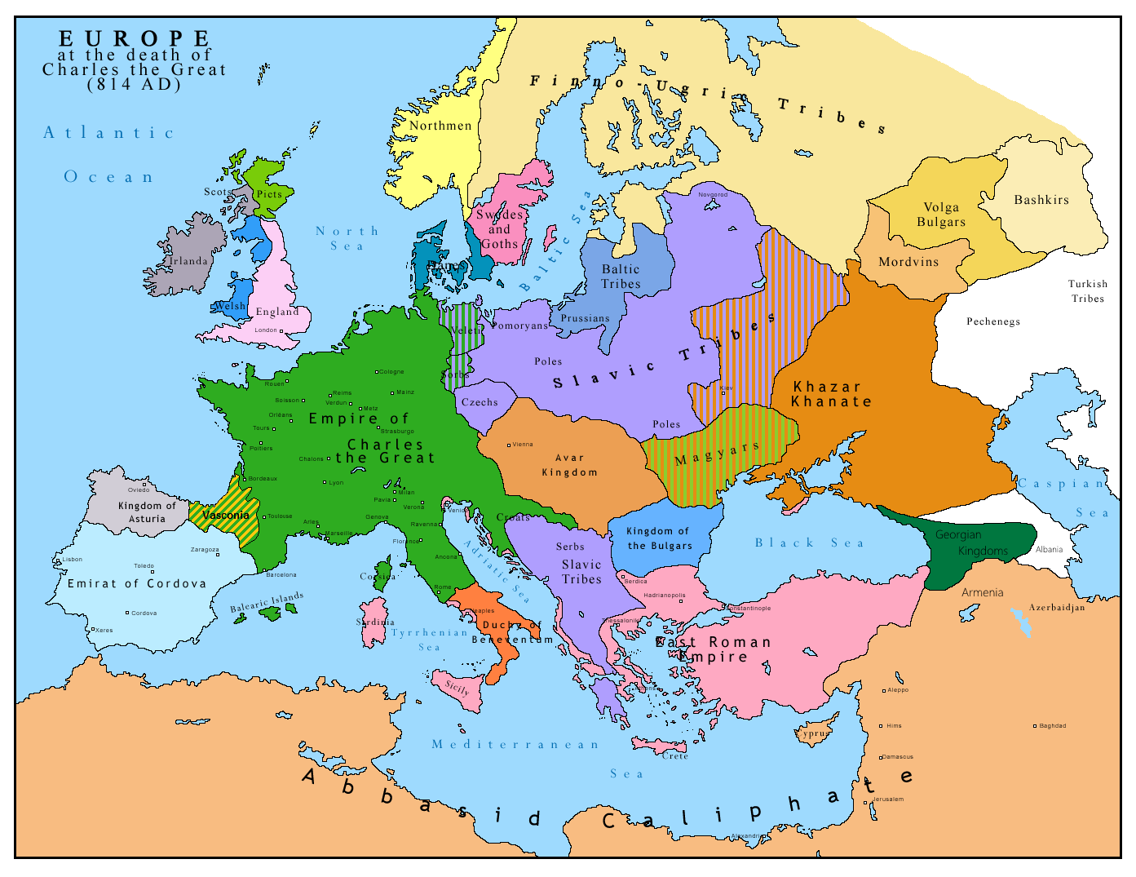
https://upload.wikimedia.org/wikipedia/commons/1/18/Europe_814.png

Slide 17
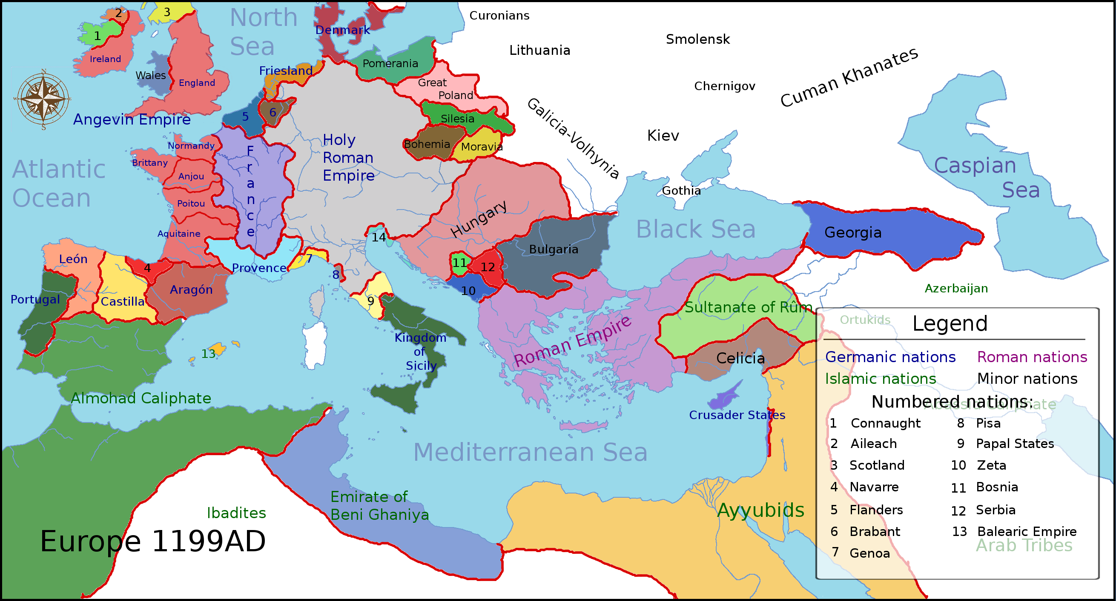
https://upload.wikimedia.org/wikipedia/commons/6/6e/Europe_1199ad_political_map.png
https://upload.wikimedia.org/wikipedia/commons/6/6e/Europe_1199ad_political_map.png

Slide 18
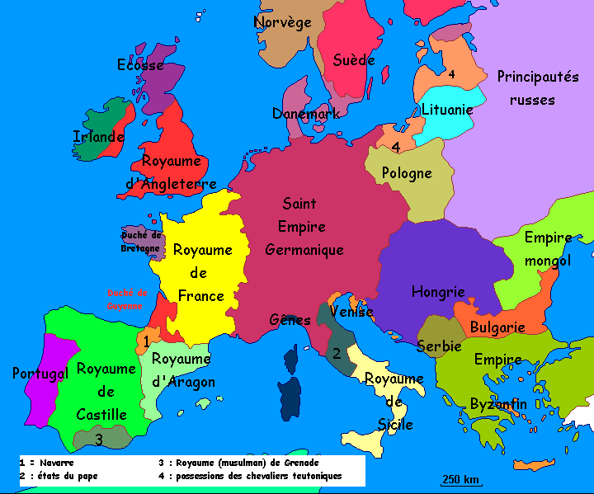
https://upload.wikimedia.org/wikipedia/commons/e/e1/Europe_in_the_13th_century.gif

Slide 19
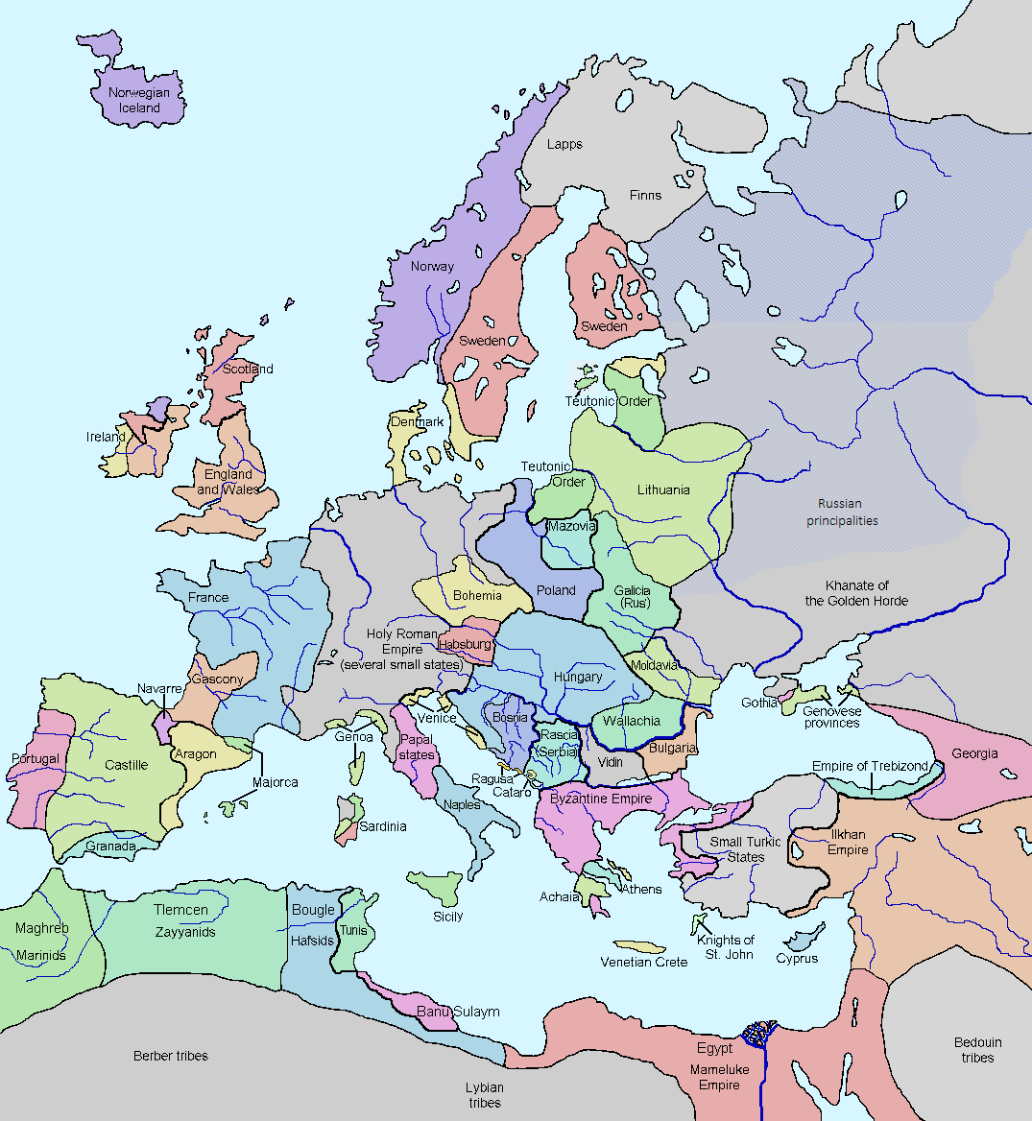
https://upload.wikimedia.org/wikipedia/commons/0/0c/Europe_in_1328.png

Slide 20
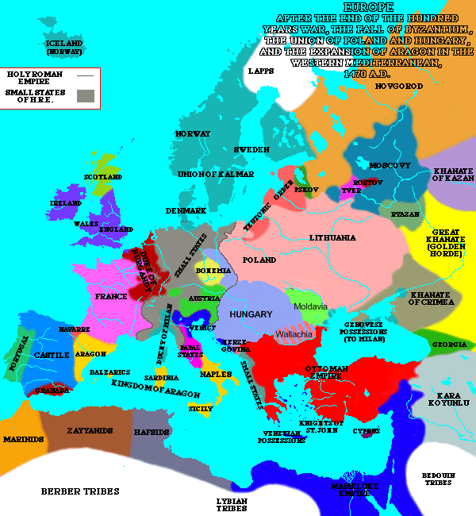
https://upload.wikimedia.org/wikipedia/commons/6/6d/Europe_in_1470.PNG

Slide 21
Western Europe 1000-1500 Political and Social life
Decline of oath bound obligations; rise of national identities;
Power of Church over Salvation;
Beginnings of “middle class”-aka bourgeois

Slide 22
Decline of Oath Bound Relationships
Oath Bound—aka “Feudalism”…bound by oath of loyalty to either lord or to land--Fealty
Support in terms of military foot soldiers, knights, taxation….in return for control of land and population.
Primarily Western Europe from 800 to 1400 A.D.

Slide 23
Why Decline?
Black Plague;
English Longbow;
Centralization of King’s (national) power;
Rise of the middle class.

Slide 24
Black Death
Reading Assignment: https://en.wikipedia.org/wiki/Black_Death

Slide 25
14th Century Pandemic
Beginning around 1350 and carried likely by fleas on rats, the Bubonic plague spread from Central Asia to China, India, Middle East Europe.
Within a decade estimated 30% of world population dies. About 50% in Western Europe

Slide 26
Aftermath in Europe
Intense persecution of Jews, lepers, other minority groups---God’s wrath, poisoned wells
Fixation of death and afterlife; repentance; or abandoned faith---shortage of clergy (caring for ill—died themselves); closing of monasteries.
Loss of work force, relationship of lord and labor more now contract less of oath based---landed estates shrink in numbers; wages increase (still fixed)
Movement toward towns and cities; countryside return to wild, much less cultivation.

Slide 27
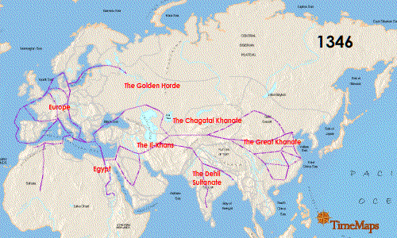
https://upload.wikimedia.org/wikipedia/commons/f/f8/Spread-Of-The-Black-Death.gif

Slide 28
English Longbow
Specially trained archers used the Welsh style longbow in 14th cent. Battles between the English and French. Arrows such force that penetrate the armor of the knights and their war horses.
Battle of Agincourt. Ends the age of the knights, begins age of a more professionally trained army. Longbows used until gunpowder fired weapons replace them in the 15th and 16th Cent.

Slide 29
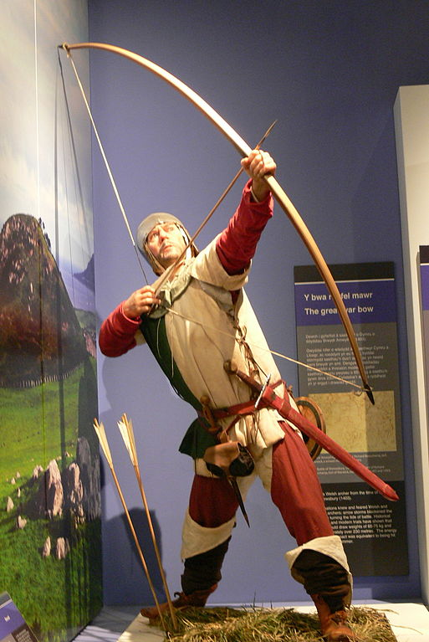
https://upload.wikimedia.org/wikipedia/commons
/thumb/c/c2/NMW_-_Bogensch%C3%BCtze.jpg
/513px-NMW_-_Bogensch%C3%BCtze.jpg

Slide 30
Rise of the Middle Class
As the merchant class and trade guilds gained greater resources in society, esp. in the 14th Cent...more social power, more economic power…lessen the oath bound relationships, focused on a more contractual relationship. Lessen control of barons and landowner class---all the way to King.
Guilds, in some places replaces the Church as the communal locus of faith and prayer.

Slide 31
Centralization of Royal power
Identity of allegiance, less on a local level, more on the person of the King and the royal family. Royal administrations;
Awareness of a sense of belonging to more than local lord, rather belonging to central royal power.
Decline of Church’s secular powers and wealth

Slide 32
The Church
Major land owner in Europe; wealth of Europe in hands of clergy
Bishops, Priests, monks, nuns, friars---communities of faith and service—education, care for the sick.
Through use of sacraments, controlled means of salvation, hope, eternal life

Slide 33
Thomas Aquinas
“Saint Thomas Aquinas : 1225 – 7 March 1274) was an Italian^{[6][7]}Dominican friar, Catholic priest, and Doctor of the Church. He was an immensely influential philosopher, theologian, and jurist in the tradition of scholasticism, within which he is also known as the Doctor Angelicus and the Doctor Communis….
He was the foremost classical proponent of natural theology and the father of Thomism; of which he argued that reason is found in God. His influence on Western thought is considerable, and much of modern philosophy developed or opposed his ideas, particularly in the areas of ethics, natural law, metaphysics, and political theory. Unlike many currents in the Church of the time,^{[9]} Thomas embraced several ideas put forward by Aristotle—whom he called "the Philosopher"—and attempted to synthesize Aristotelian philosophy with the principles of Christianity.^{[10]} His best-known works are the Disputed Questions on Truth (1256-59), the Summa Theologiae (1261-63) and the Summa contra Gentiles (1265-73). ….
The Catholic Church honors Thomas Aquinas as a saint and regards him as the model teacher for those studying for the priesthood, and indeed the highest expression of both natural reason and speculative theology. “
https://en.wikipedia.org/wiki/Thomas_Aquinas

